Slide 1
Supervised – Unsupervised learning Gradient descent algorithm
Học kỳ 1, năm học 2017-2018

Slide 2
Outline
Review
Gradient Descent for multiple features
Regularization
Evaluate your hypothesis
Model selection/train, validation, test set

Slide 3
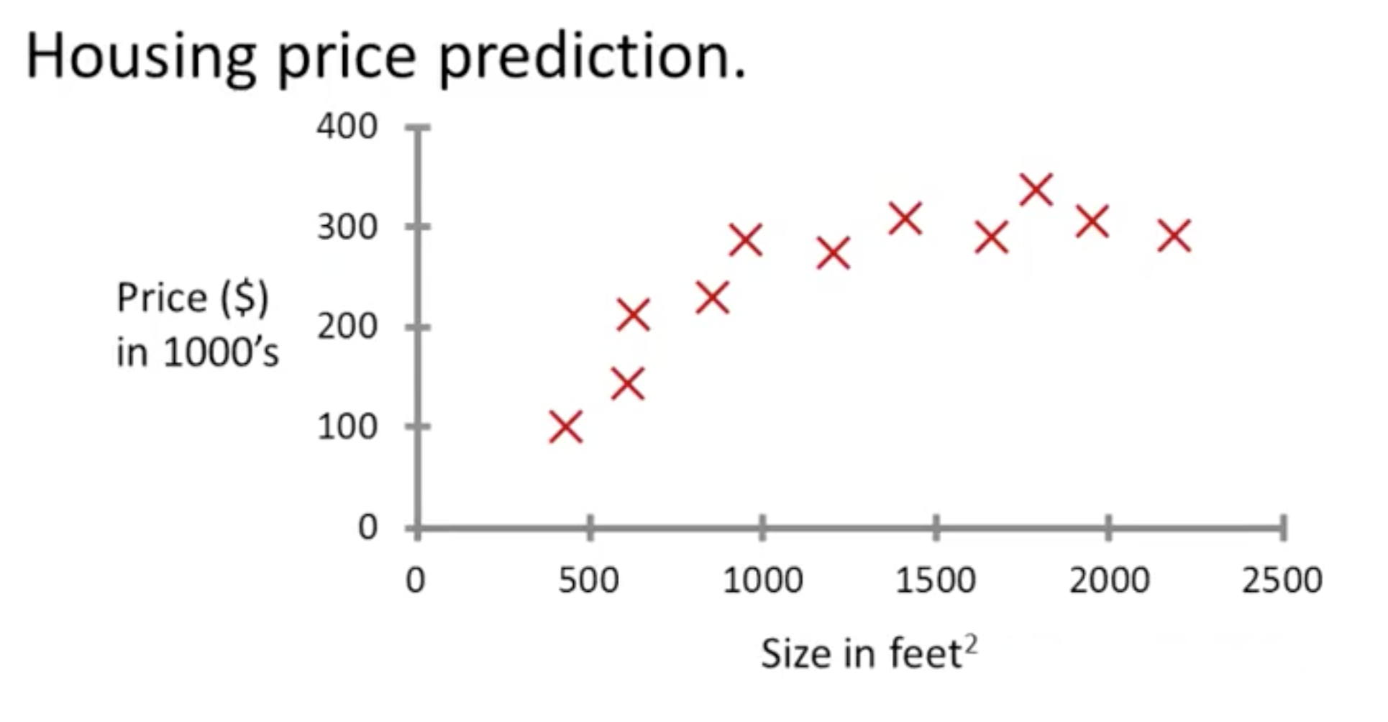
Supervised learning

Slide 4
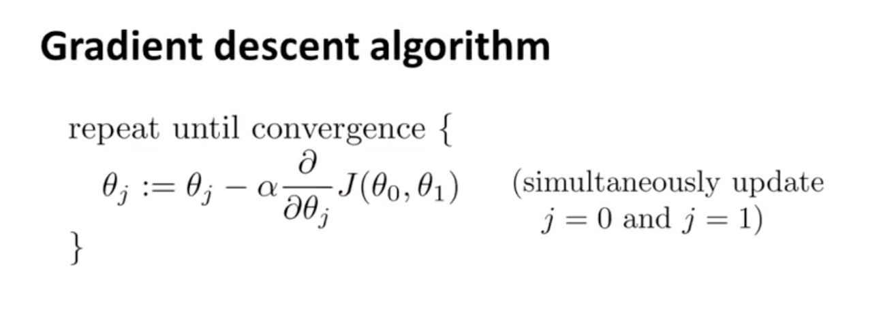
Gradient descent

Slide 5
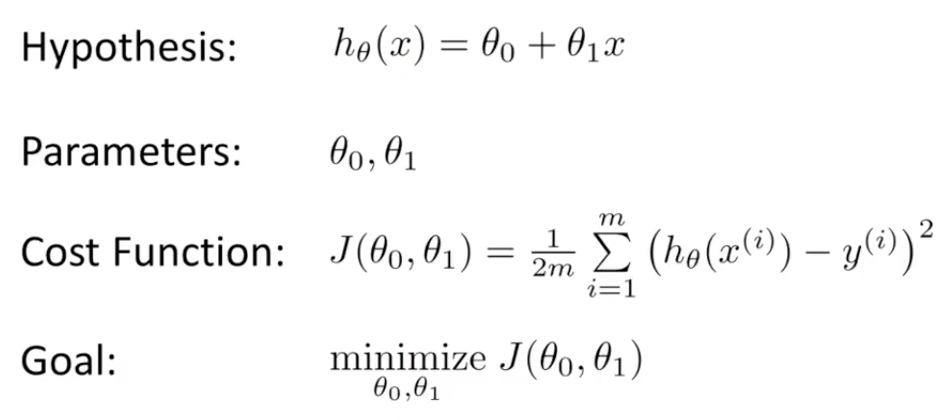
Cost function

Slide 6
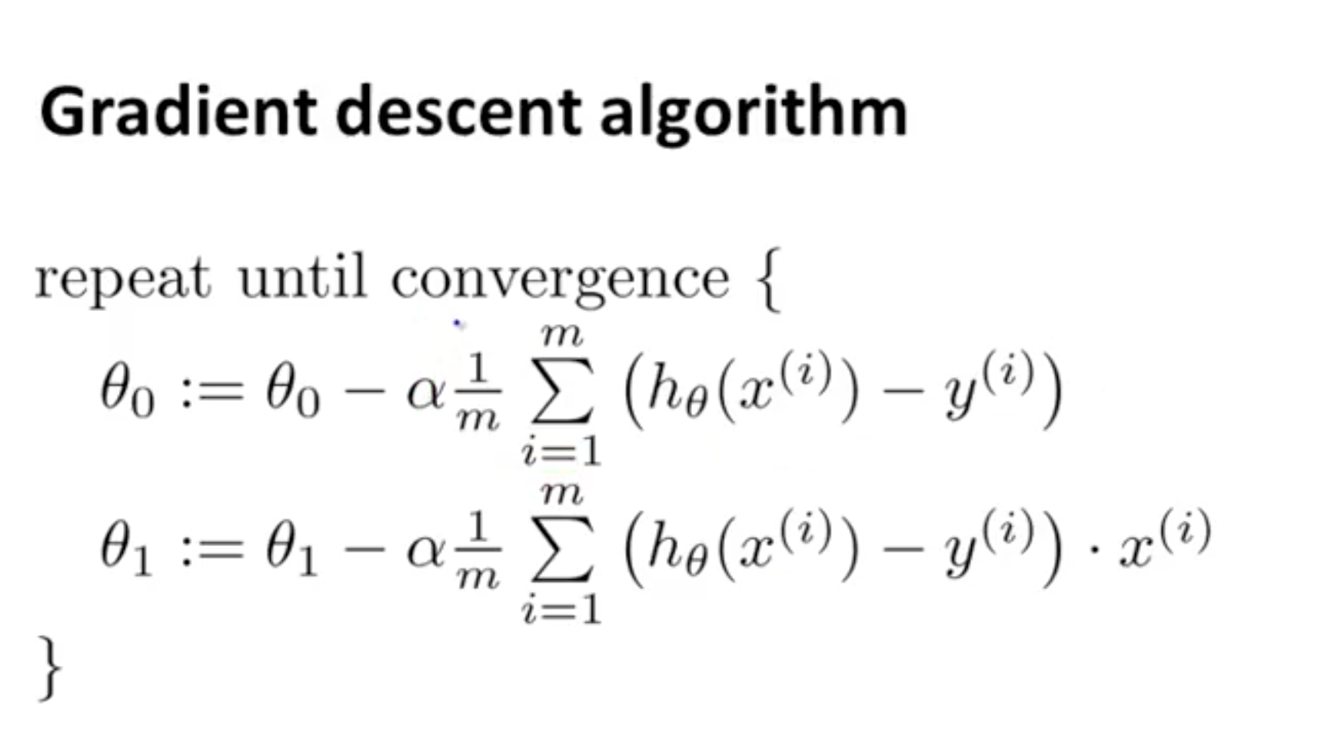
Gradient descent for linear regression

Slide 7
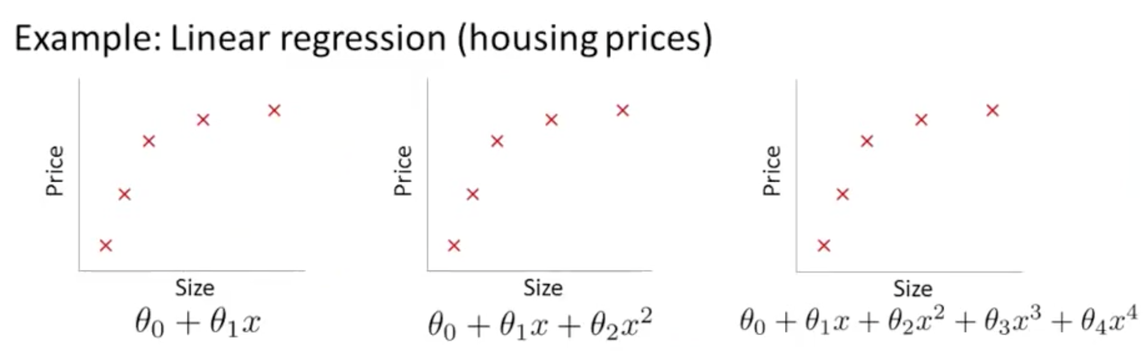
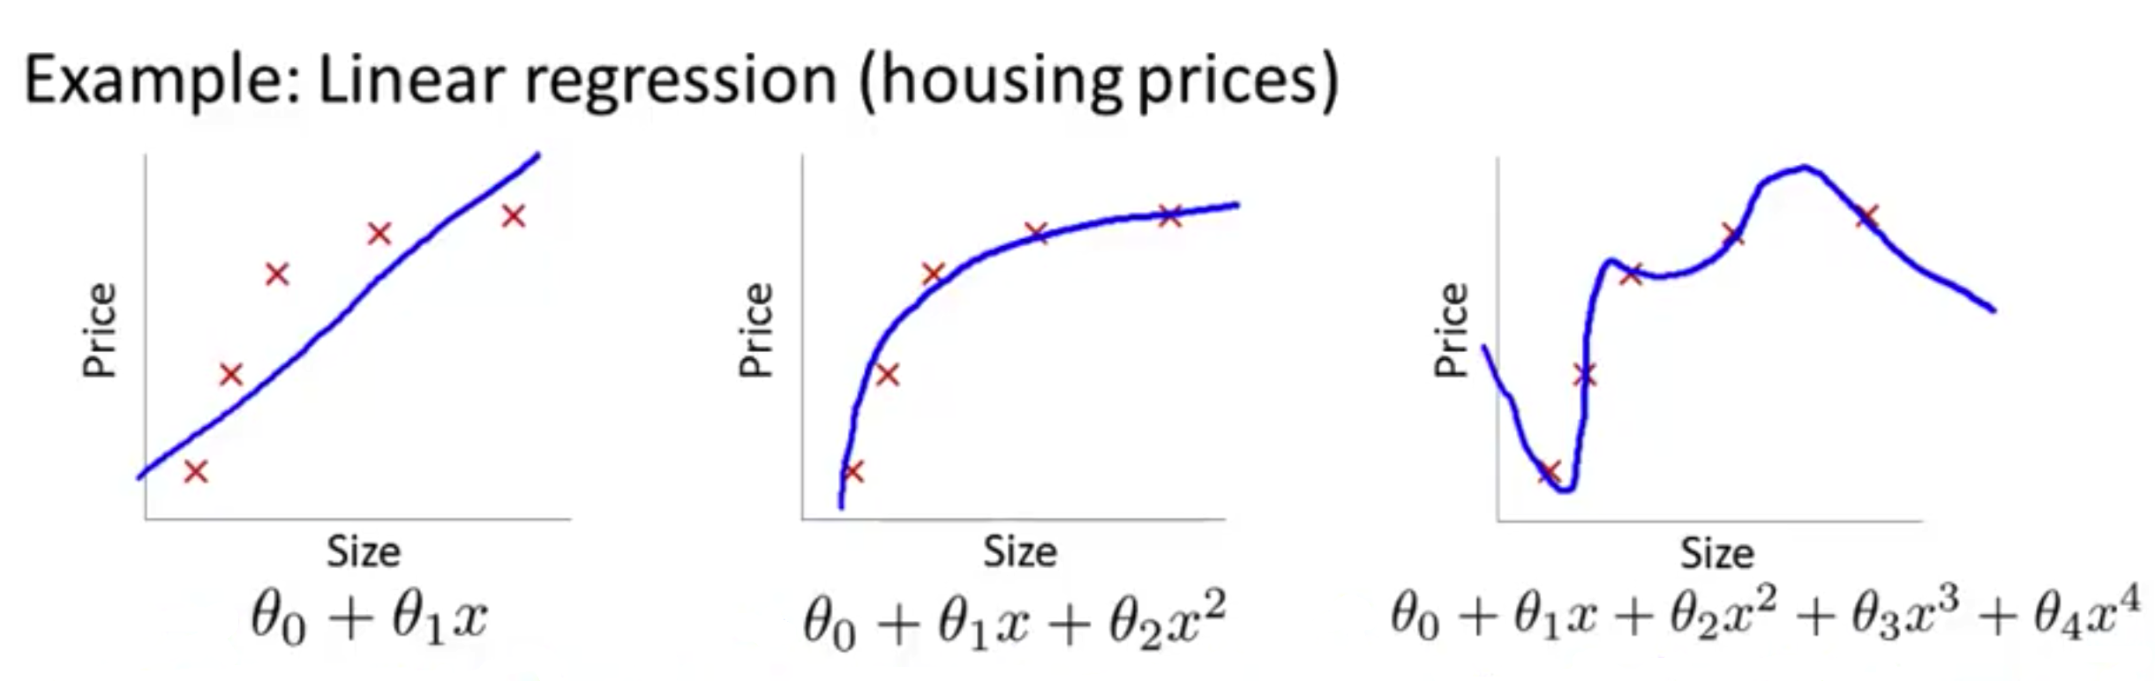
The problem of overfitting
Underfit - High bias
FIT
Overfit - High variance

Slide 8
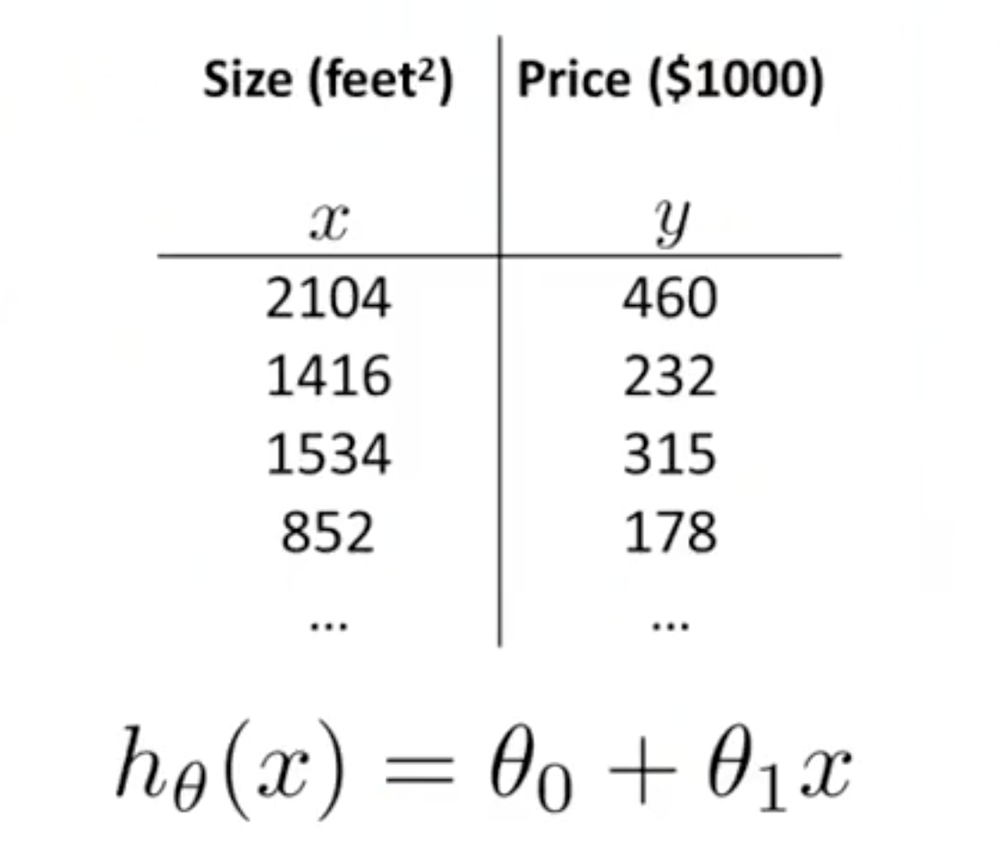
Multiple Features

Slide 9
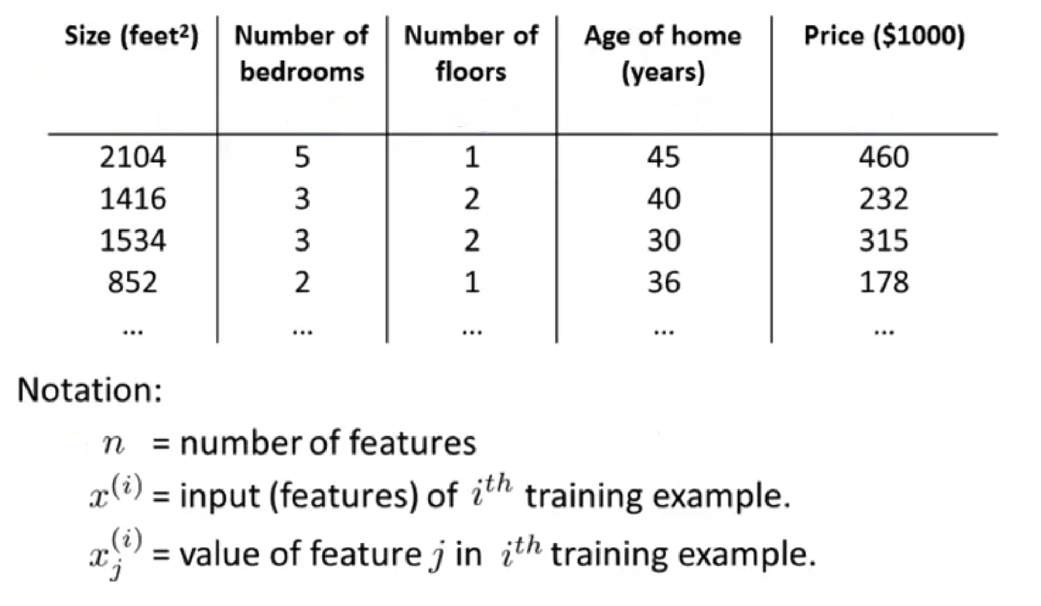
Multiple Features
x₁
x₂
x₃
x₄
y
Notes:
Cho vi du ve x(2)

Slide 10
Gradient Descent for Multiple Features
Hypothesis:
Previously:
h_{Θ}(x) = Θ₀ + Θ₁x
Now:
h_{Θ}(x) = Θ₀ + Θ₁x₁ + Θ₂x₂ + Θ₃x₃ + Θ₄x₄
h_{Θ}(x) = 12 + 0.1x₁ + 2x₂ + 7.8x₃ - 0.02x₄

Slide 11
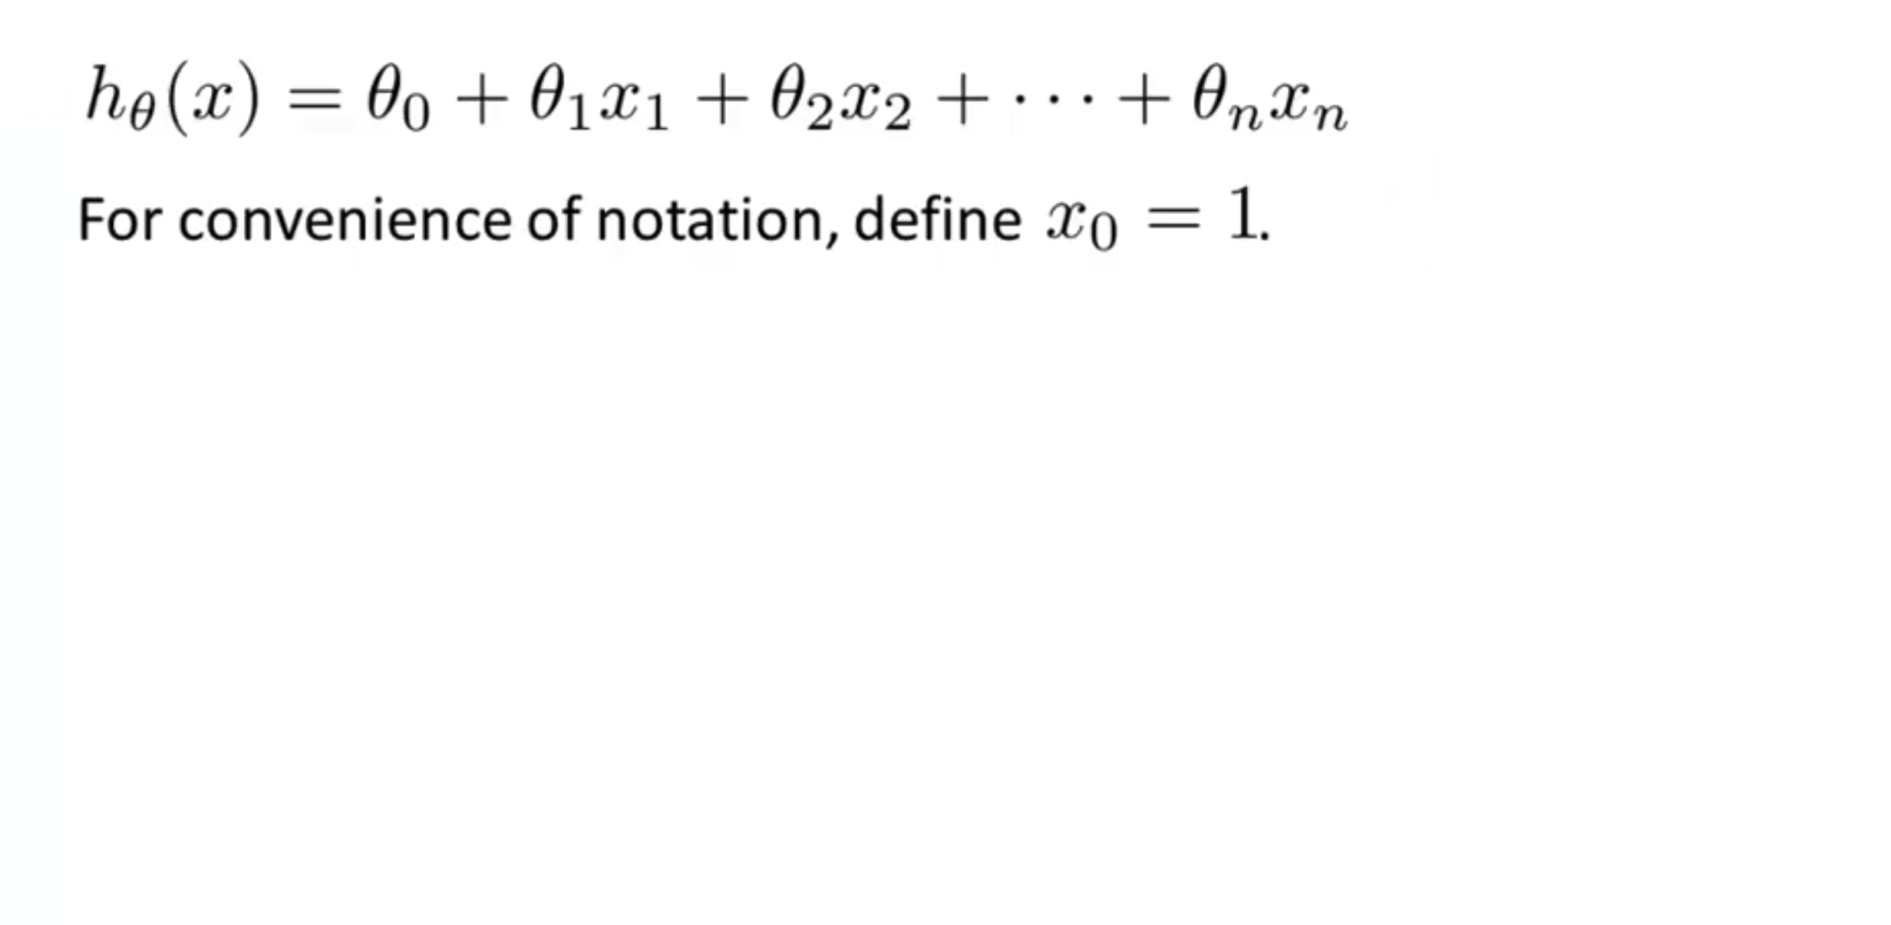
Gradient Descent for Multiple Features
h_{Θ}(x) = Θ₀x₀+ Θ₁x₁ + Θ₂x₂ + … + Θ_{n}x_{n} = Θ^{T}x
Notes:
Ghi chu x0 = 1, va ve ra theta ^ T

Slide 12
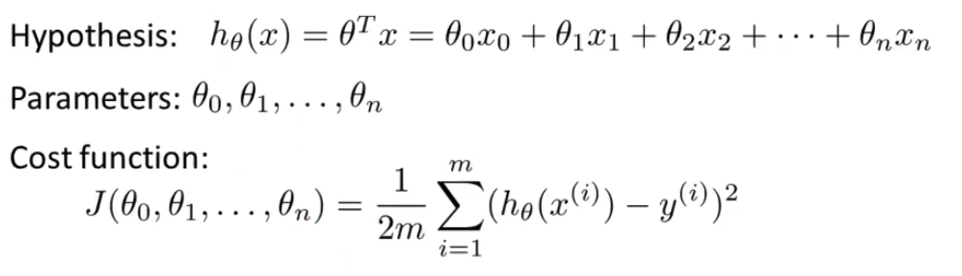
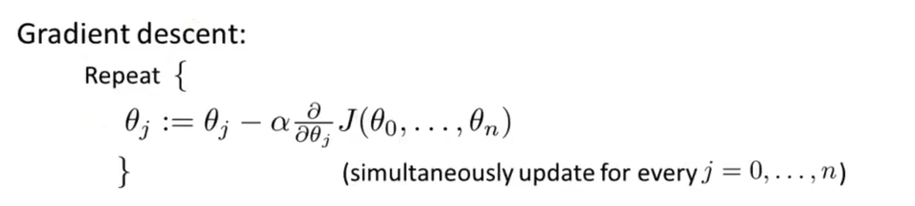
Gradient Descent for Multiple Features
➣Θ
➣Θ
➣Θ

Slide 13
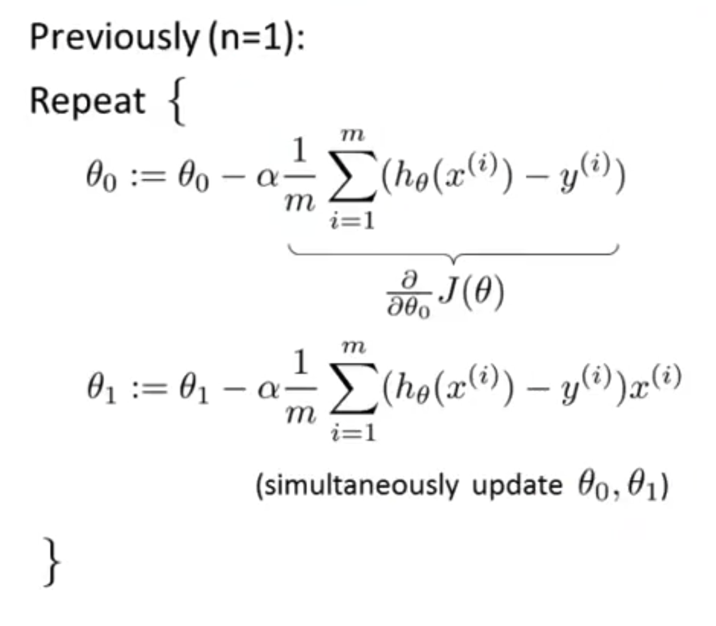
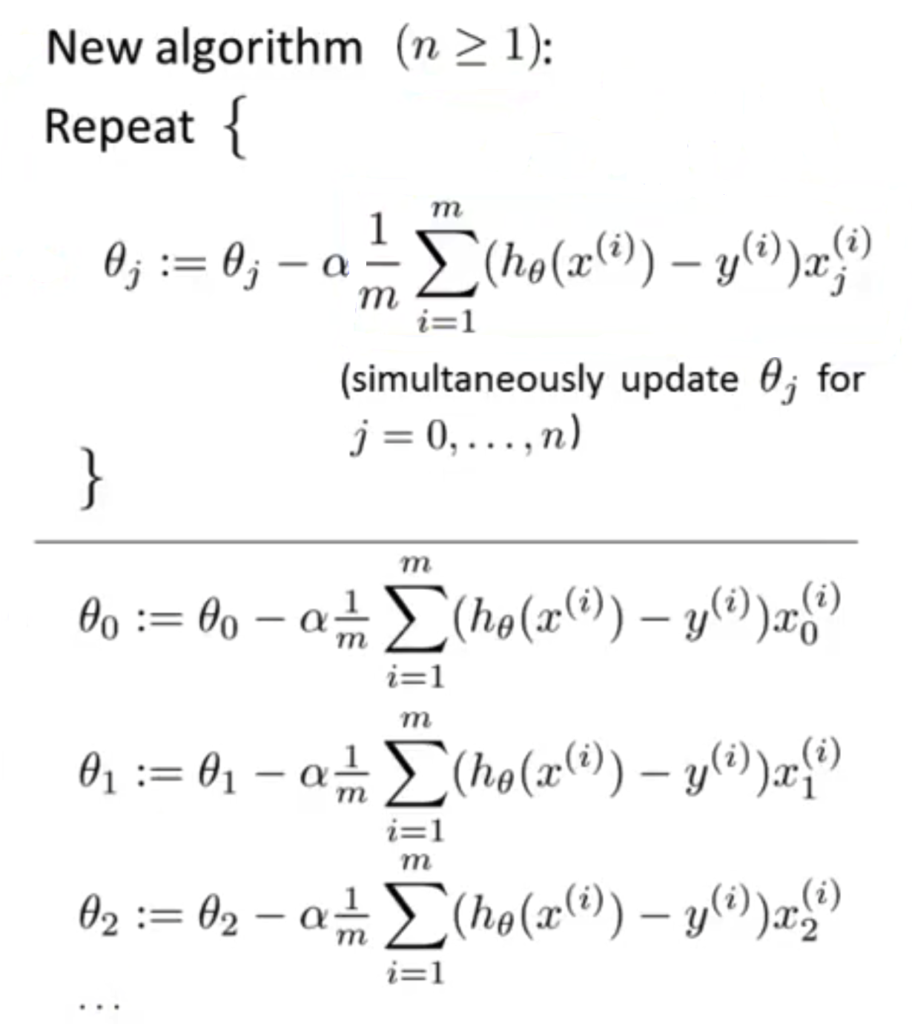
Gradient Descent for Multiple Features

Slide 14
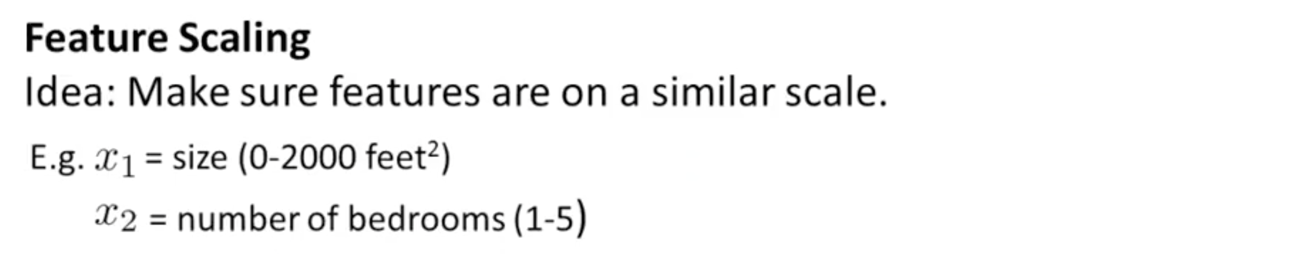
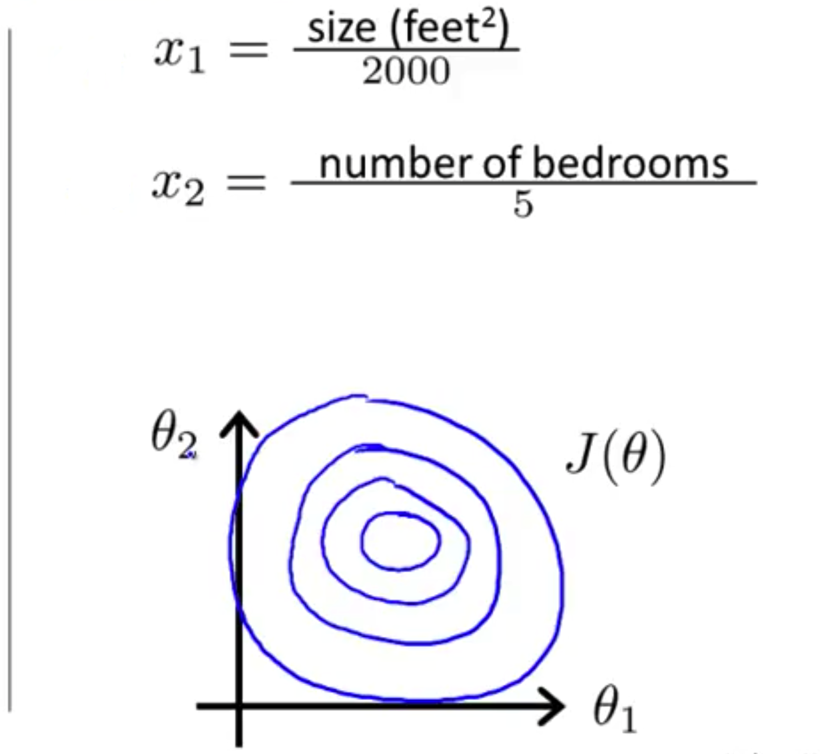
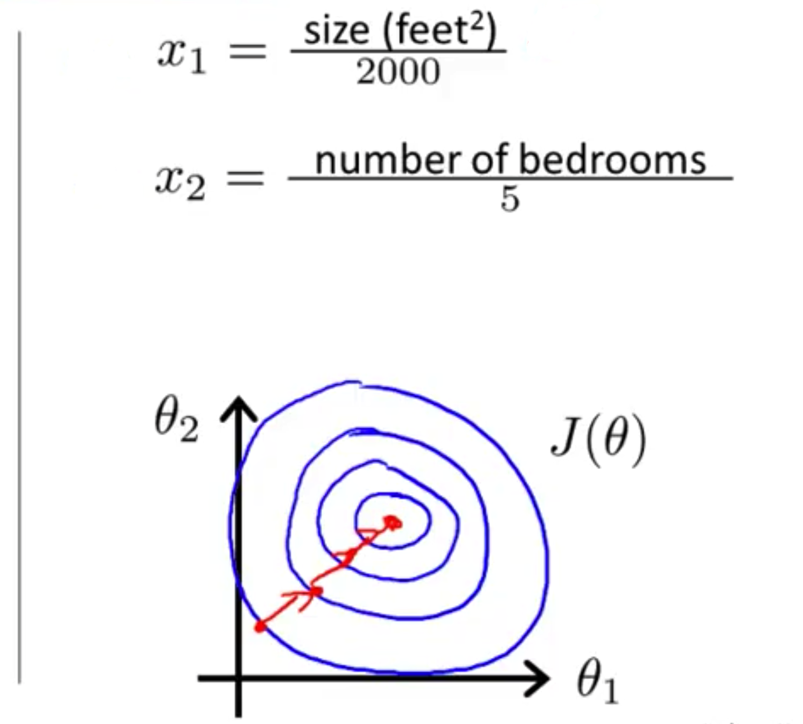
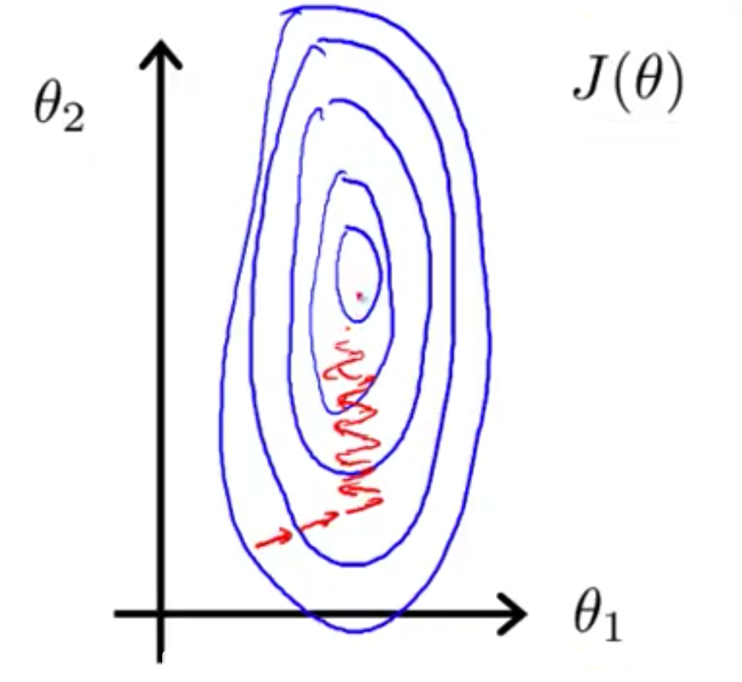
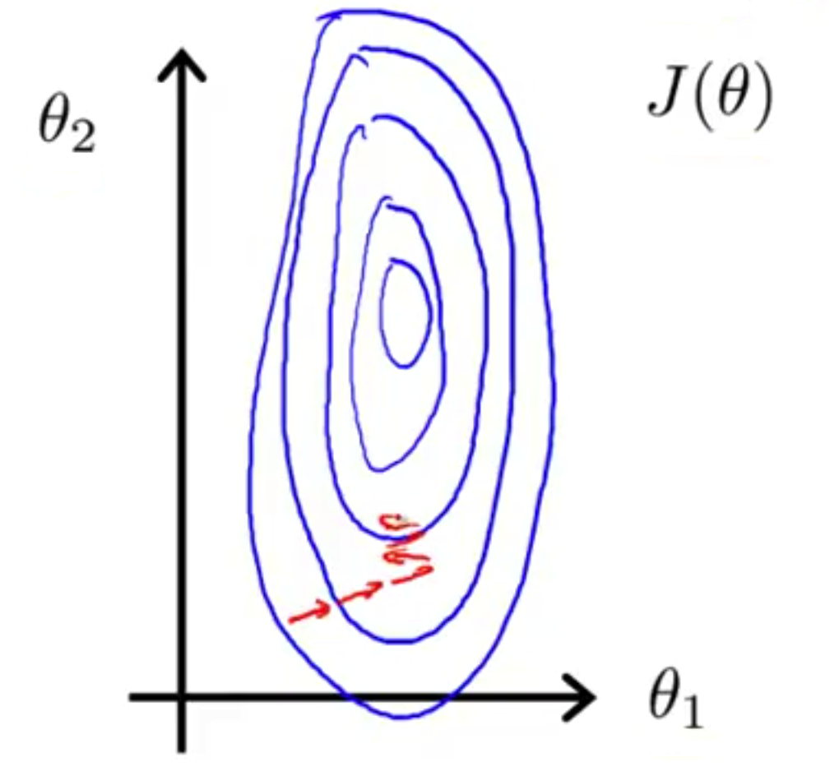
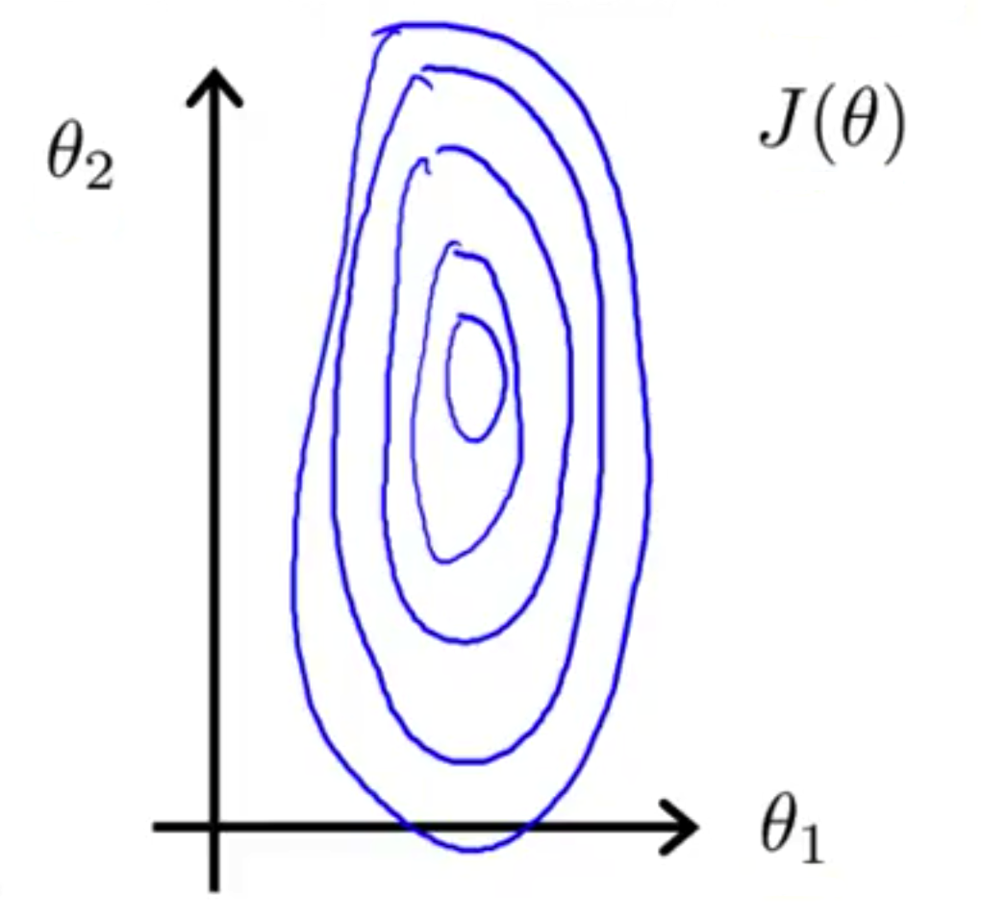
In practice 1: feature scaling
Notes:
Cho vi du ve x(2)

Slide 15
In practice 1: feature scaling
Get every feature into approximately a -1 ≤ x_{i} ≤ 1 range
0 ≤ x₁ ≤ 3
-2 ≤ x₂ ≤ 0.5
-100 ≤ x₃ ≤ 100
-0.00001 ≤ x₄ ≤ 0.00001

Slide 16
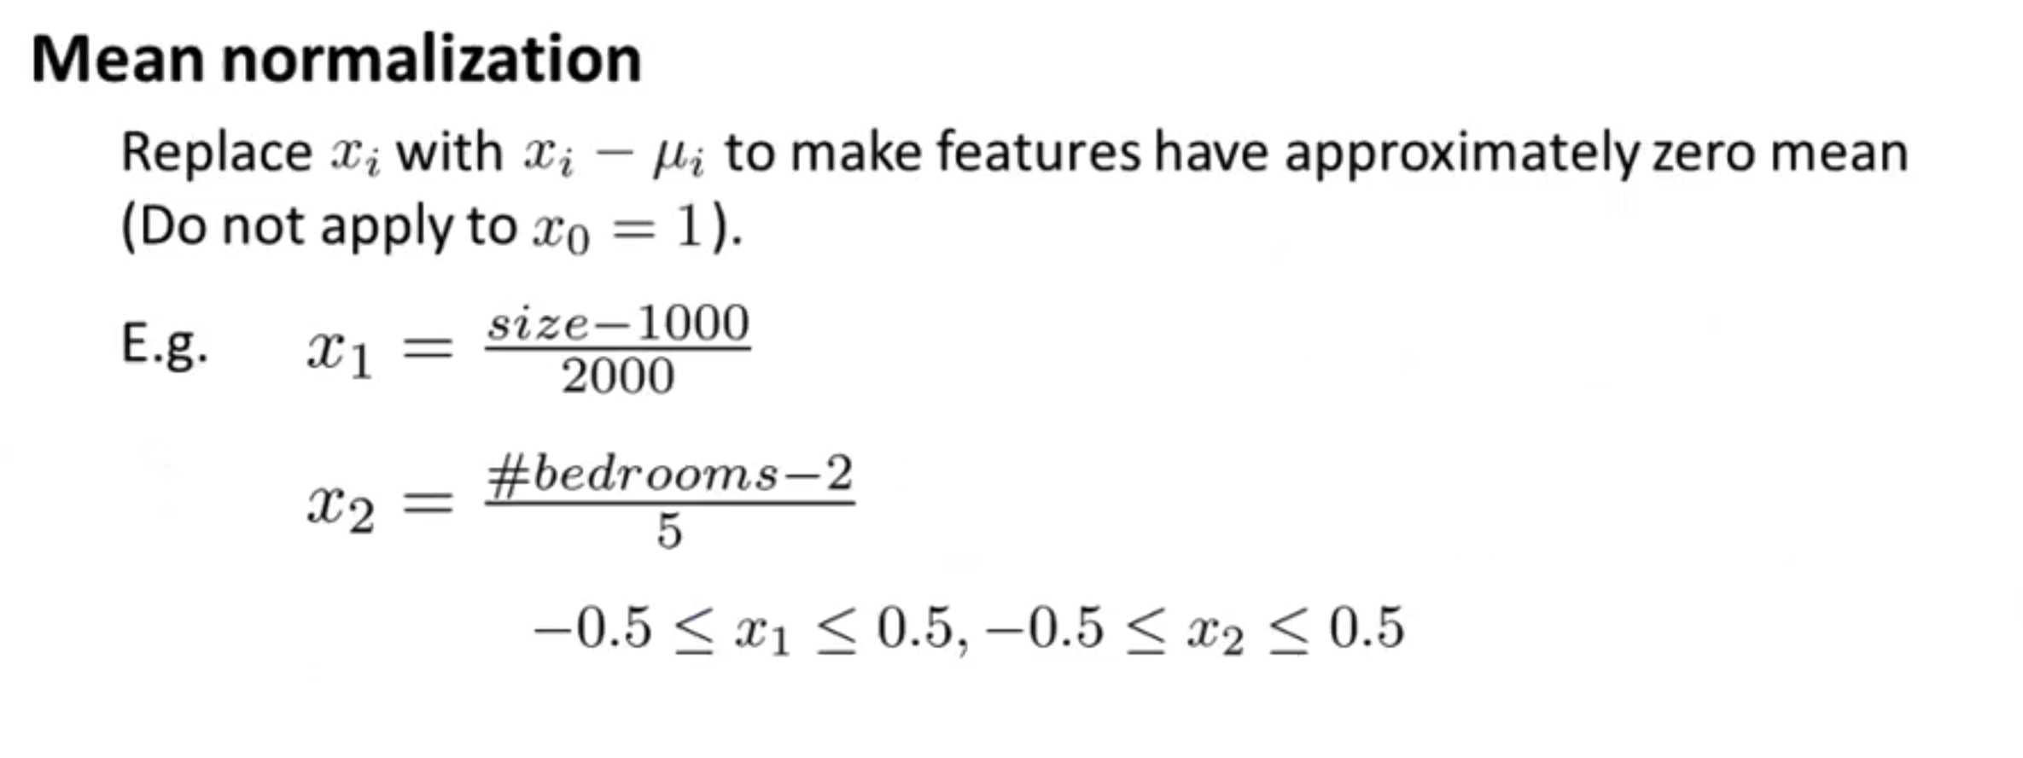
In practice 1: feature scaling

Slide 17
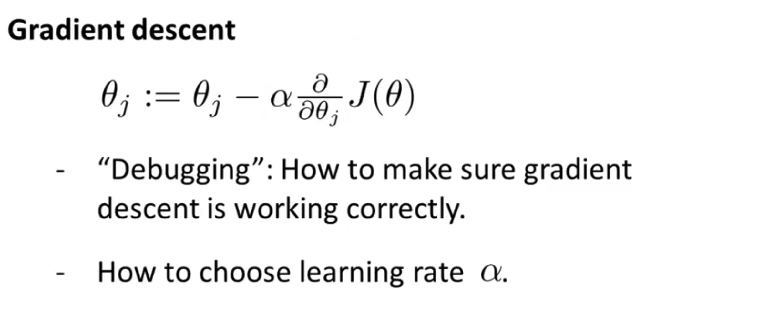
In practice 2: learning rate

Slide 18
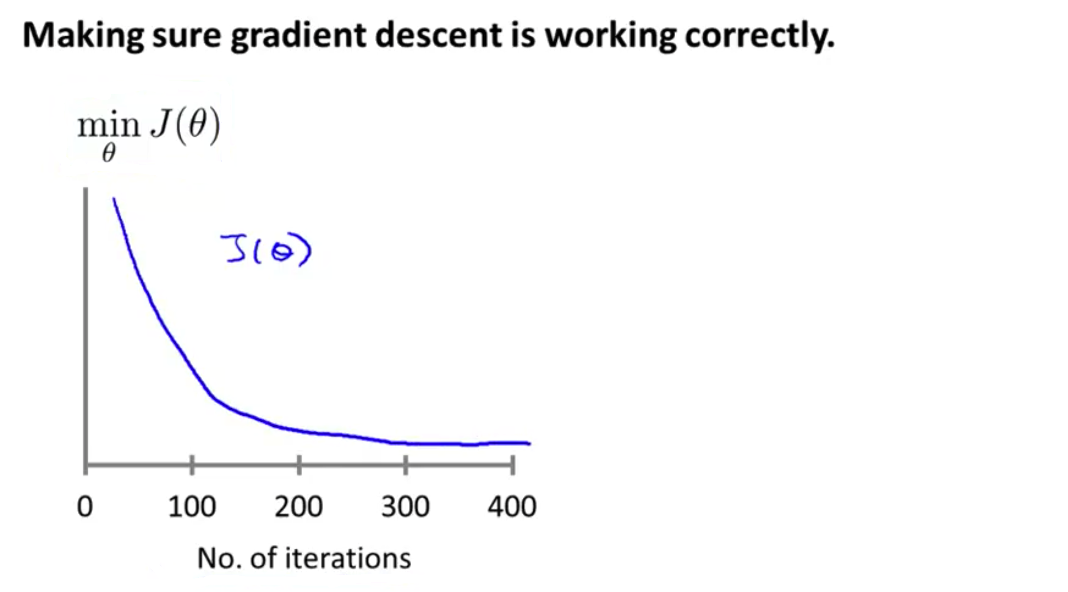
In practice 2: learning rate
J(𝜃) should decrease after every iteration
Example automatic converge test: if J(𝜃) decresase by less than 0.001 in one iteration

Slide 19
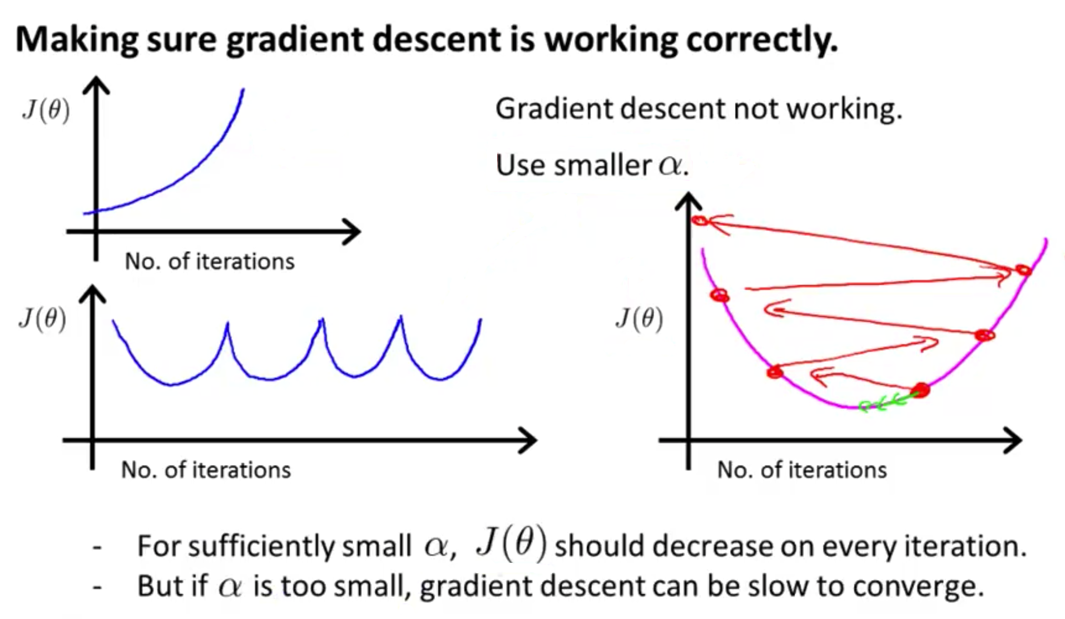
In practice 2: learning rate

Slide 20
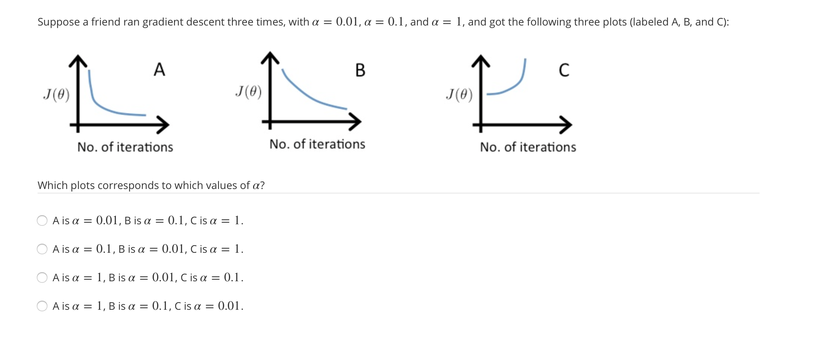
In practice 2: learning rate

Slide 21
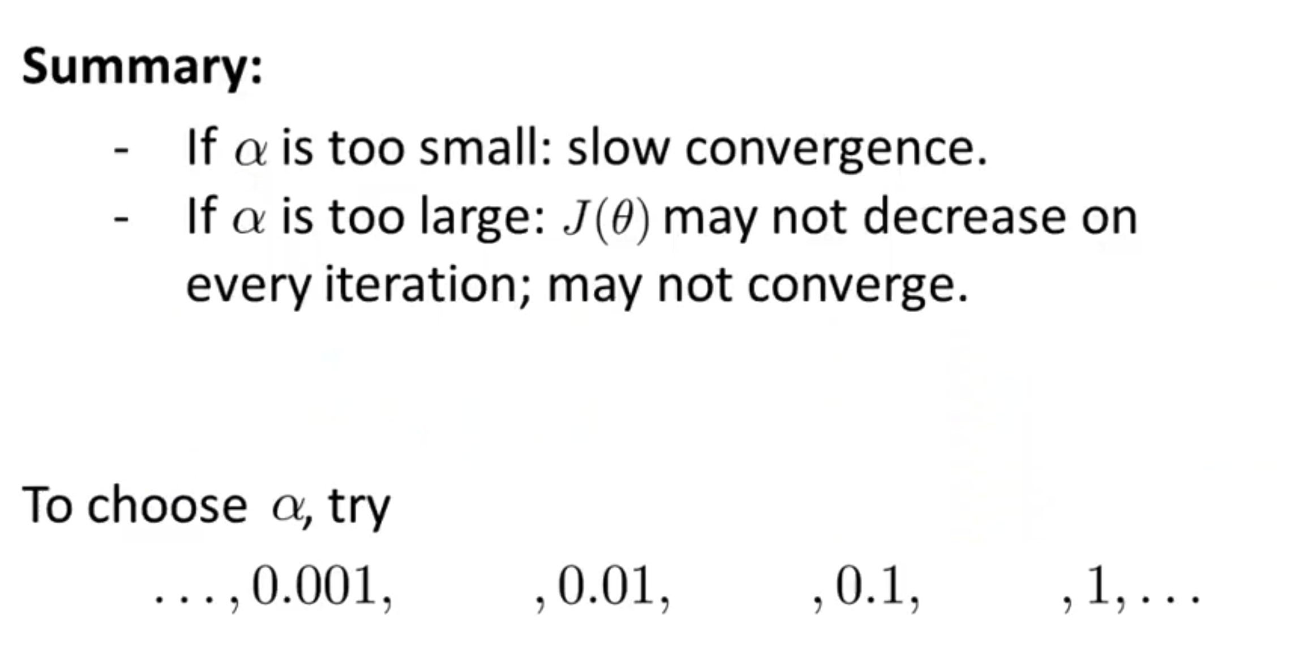
In practice 2: learning rate

Slide 22
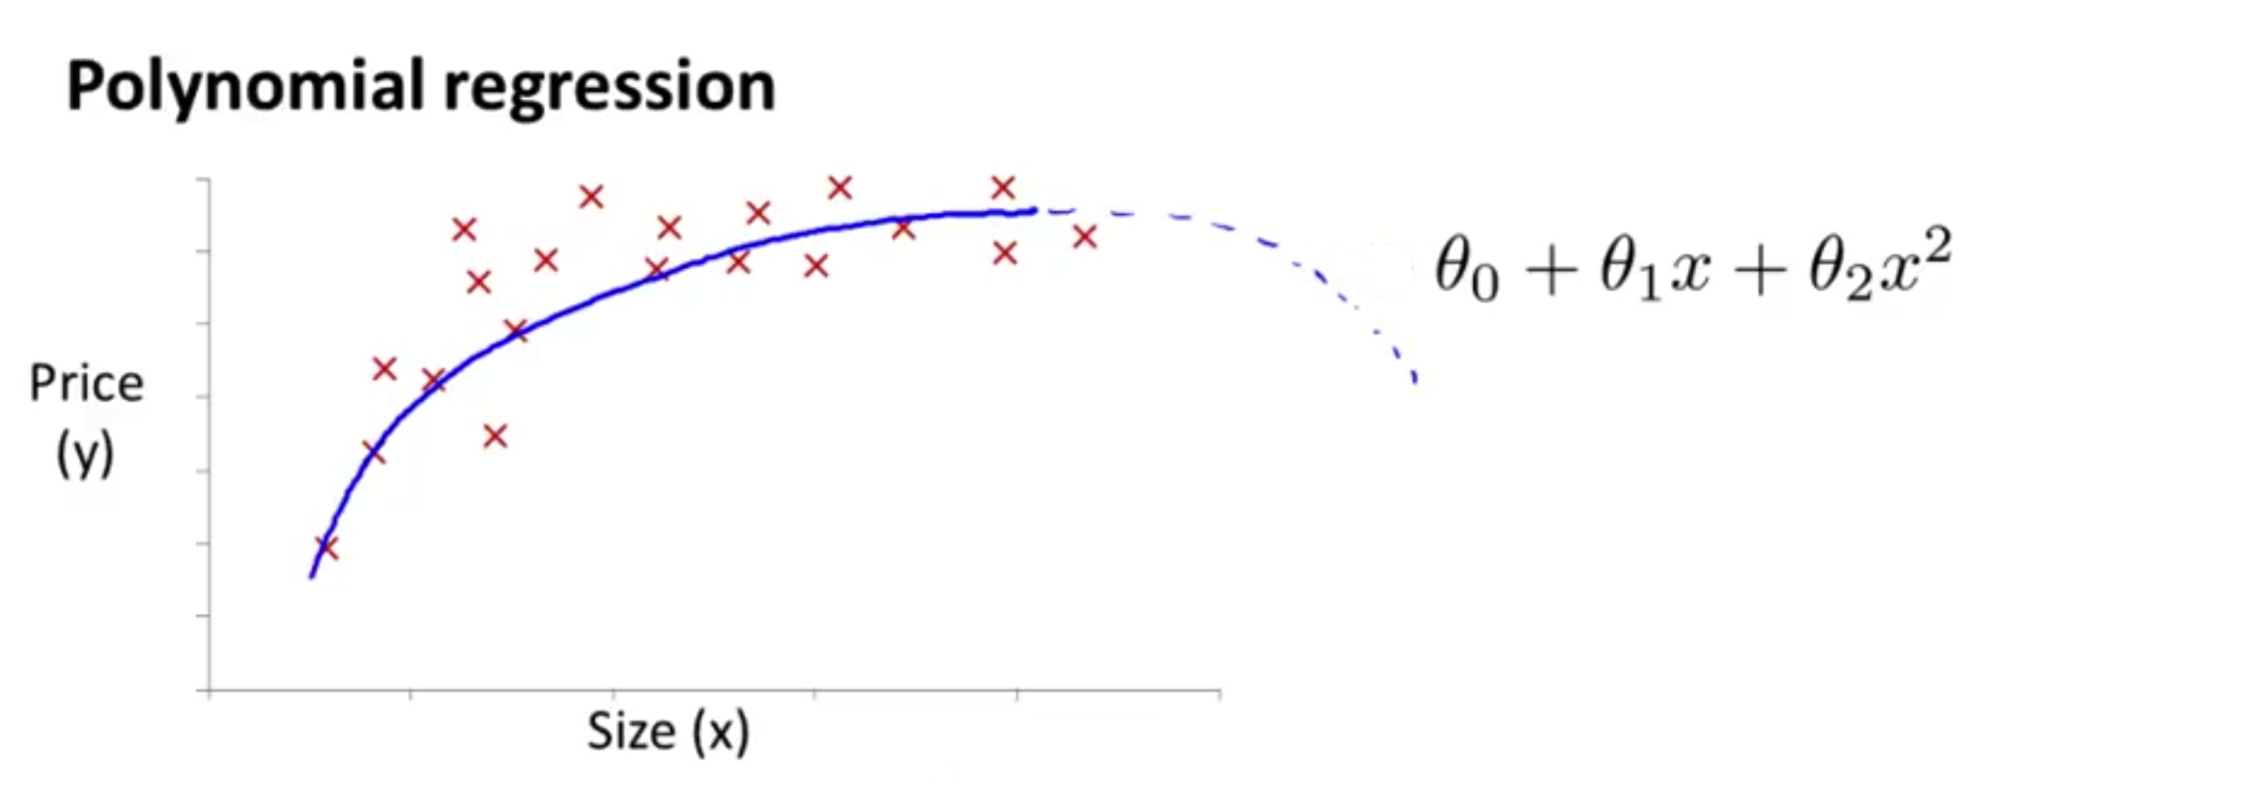
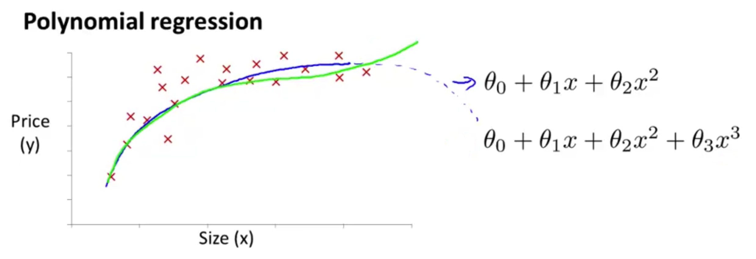
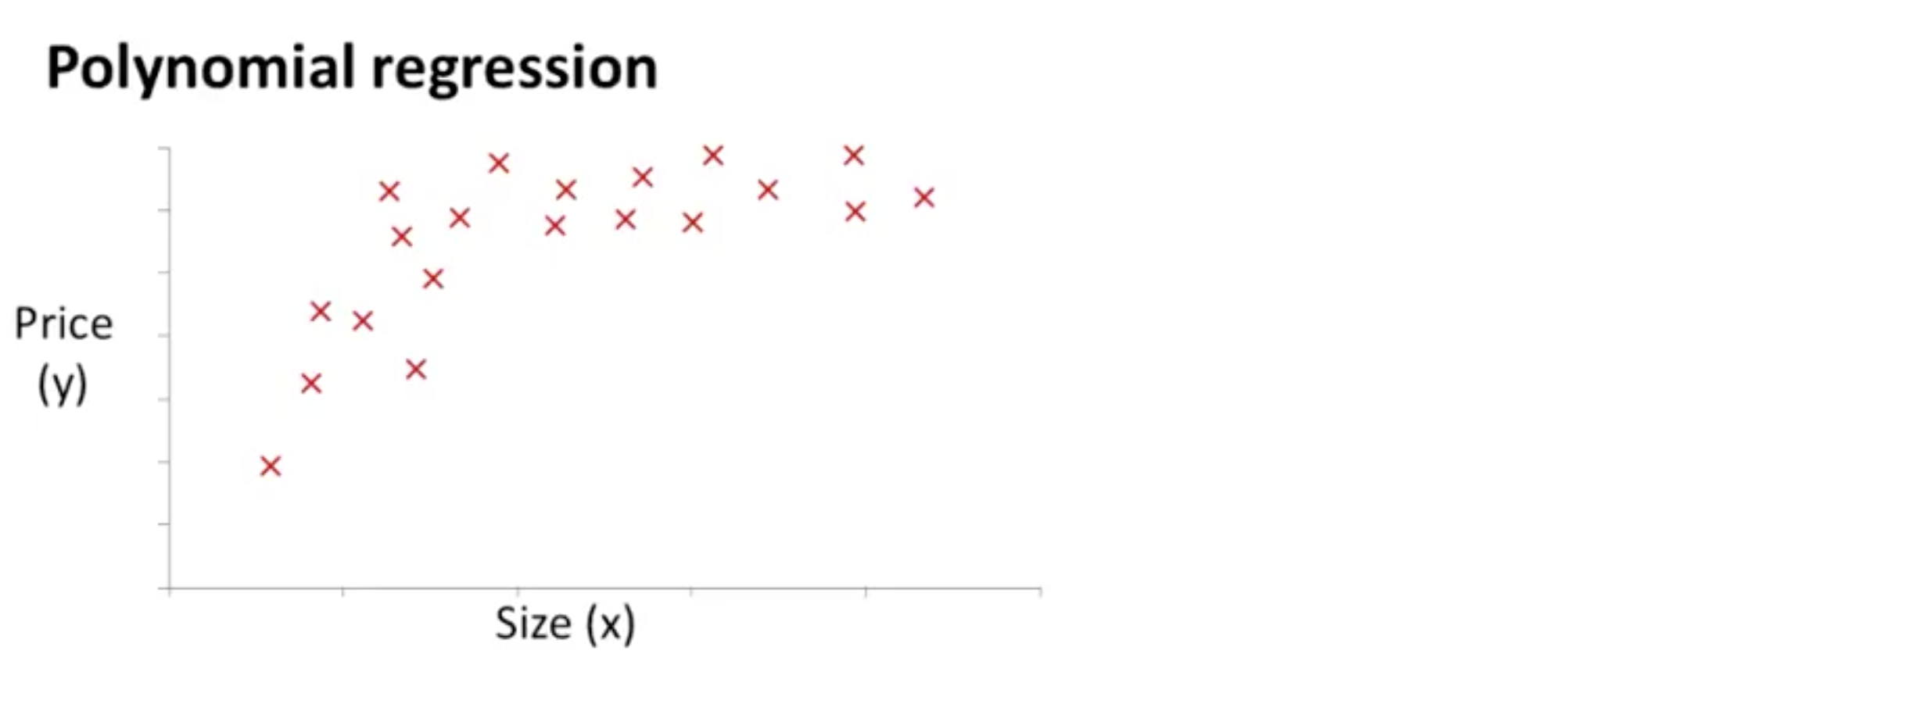
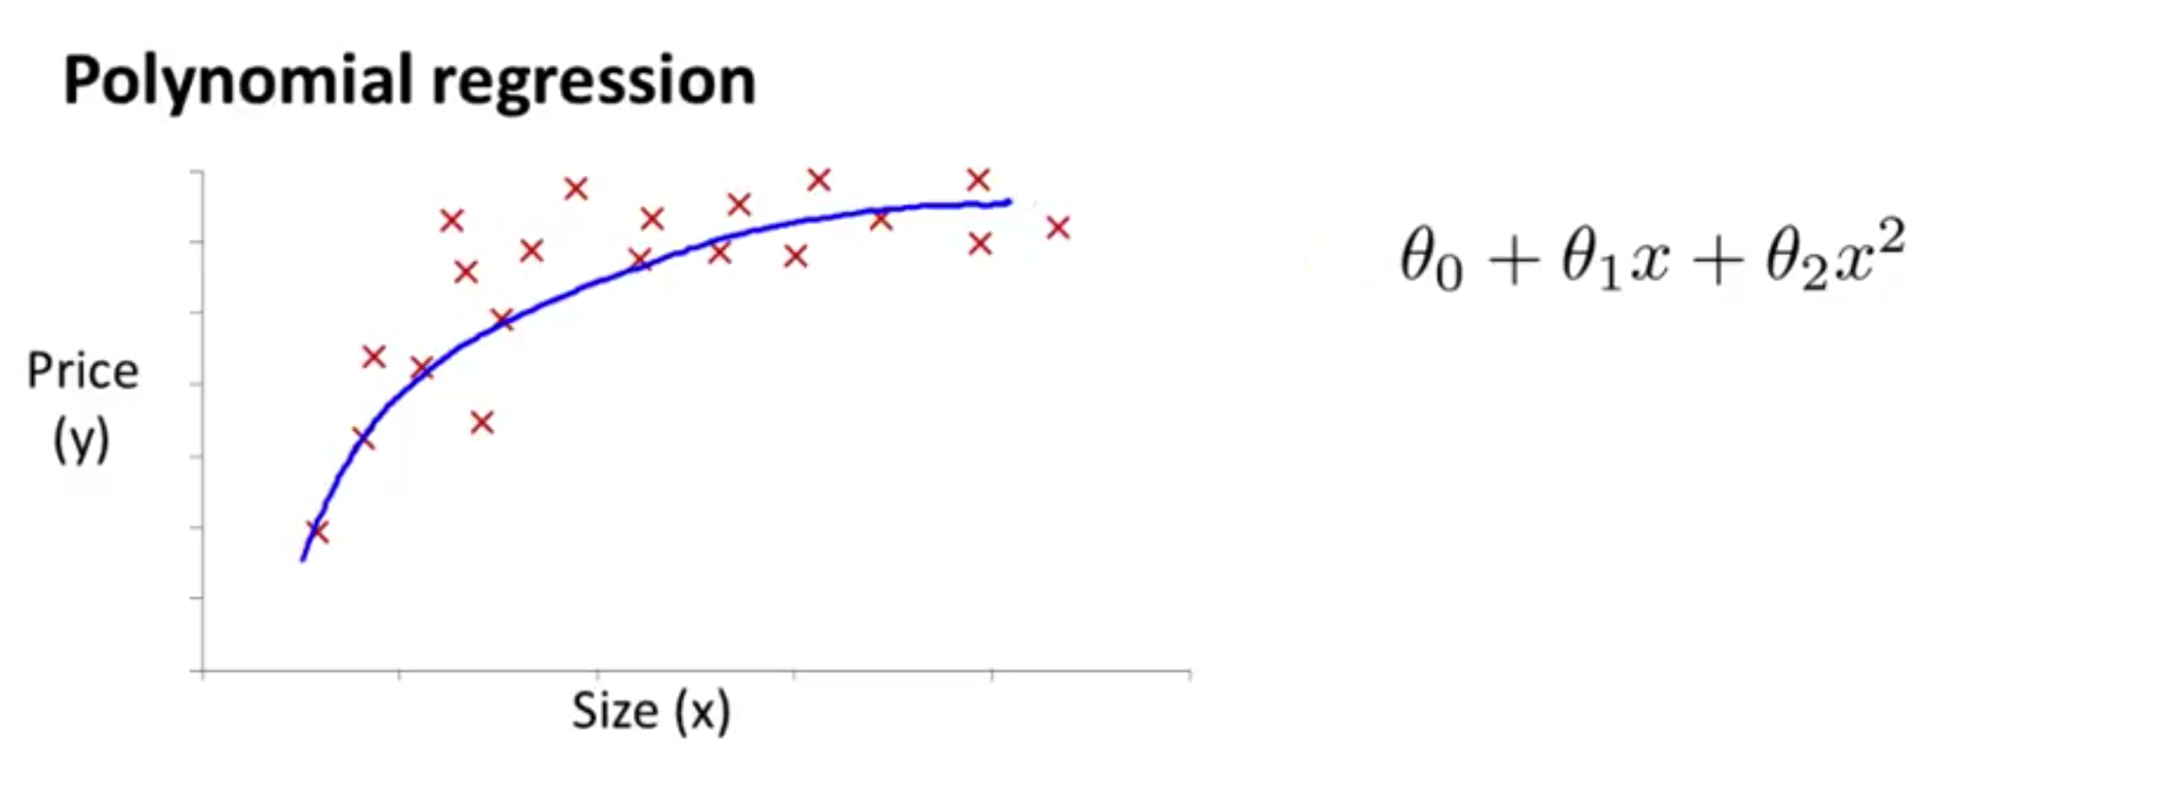
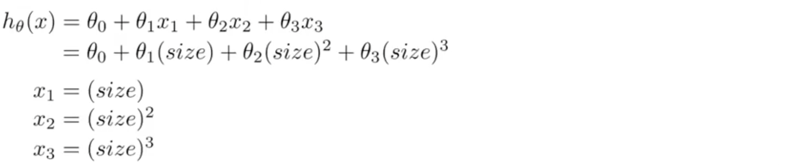
Feature and polynomial regression
Size : 1 – 1,000
Size² : 1 – 1,000,000
Size³ : 1 – 10⁹
→ Feature Scaling

Slide 23
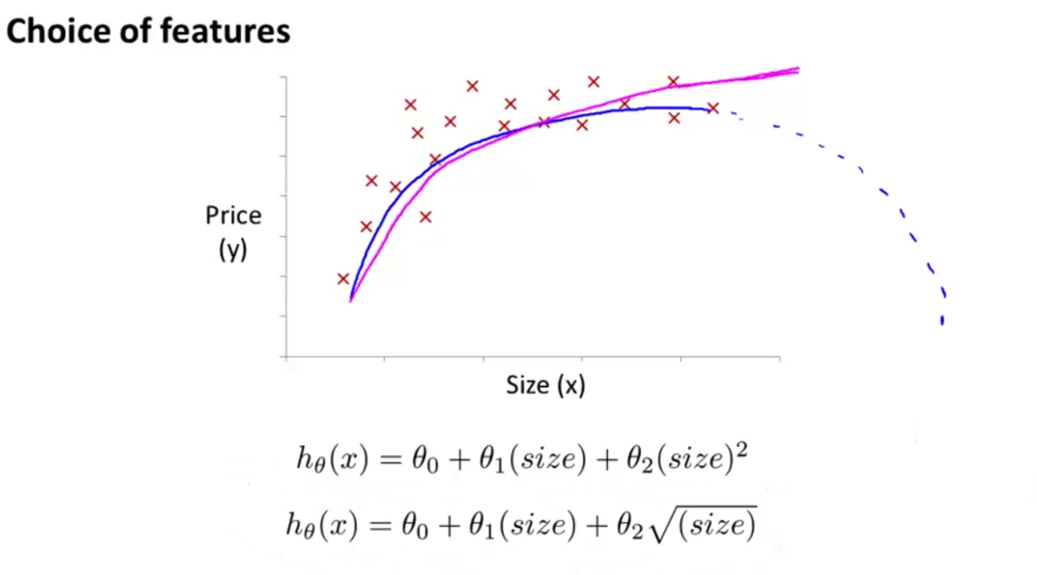
feature and polynomial regression
Notes:
y = w0 x ^ w1

Slide 24
The problem of overfitting
Underfit - High bias
FIT
Overfit - High variance
Overfitting: If we have too many features, the learned hypothesis may fit the trainning set very well, but fail to generalize to new examples.

Slide 25
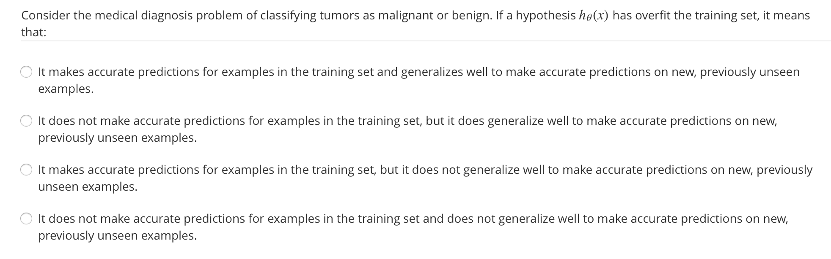
The problem of overfitting

Slide 26
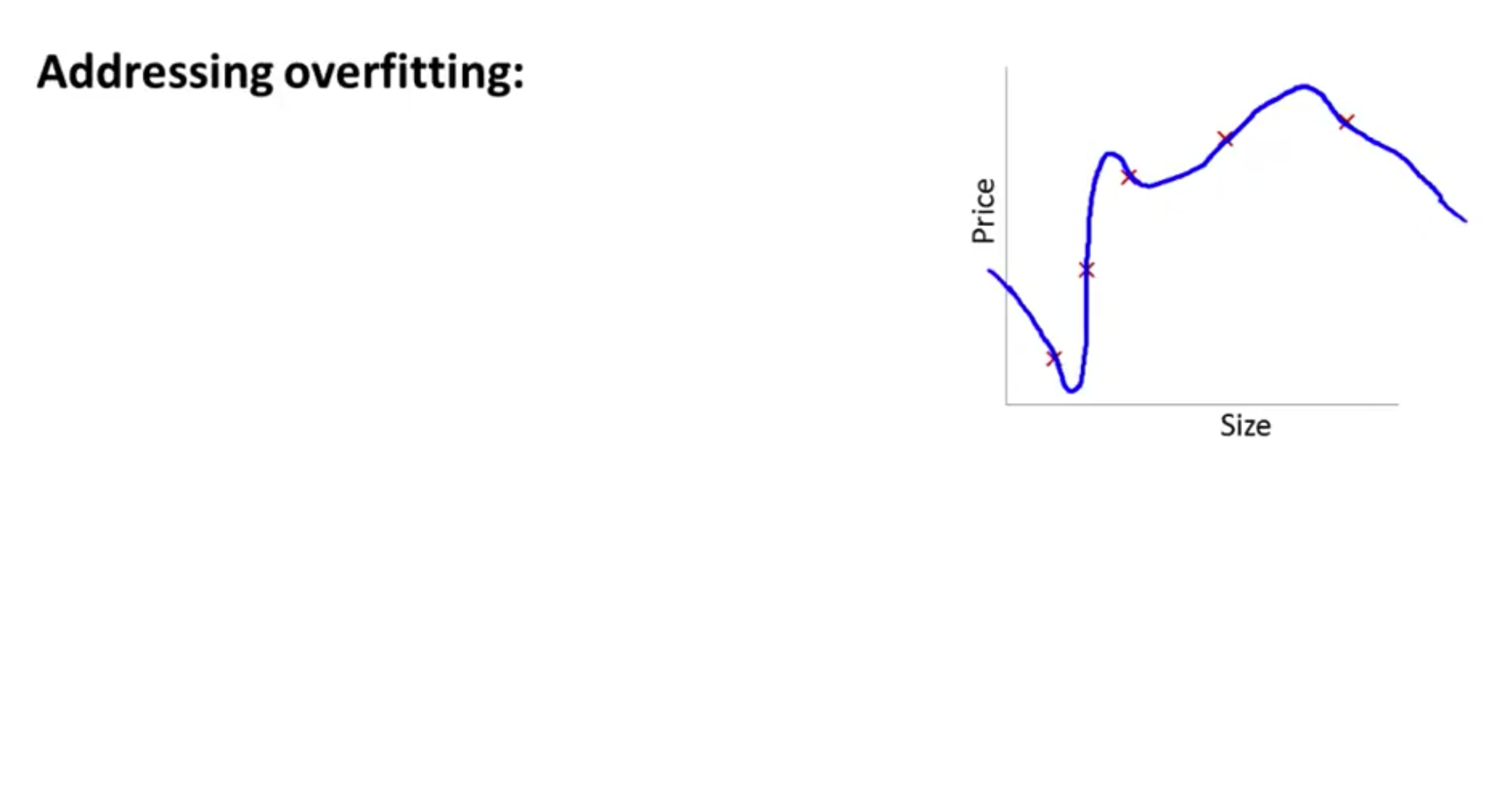
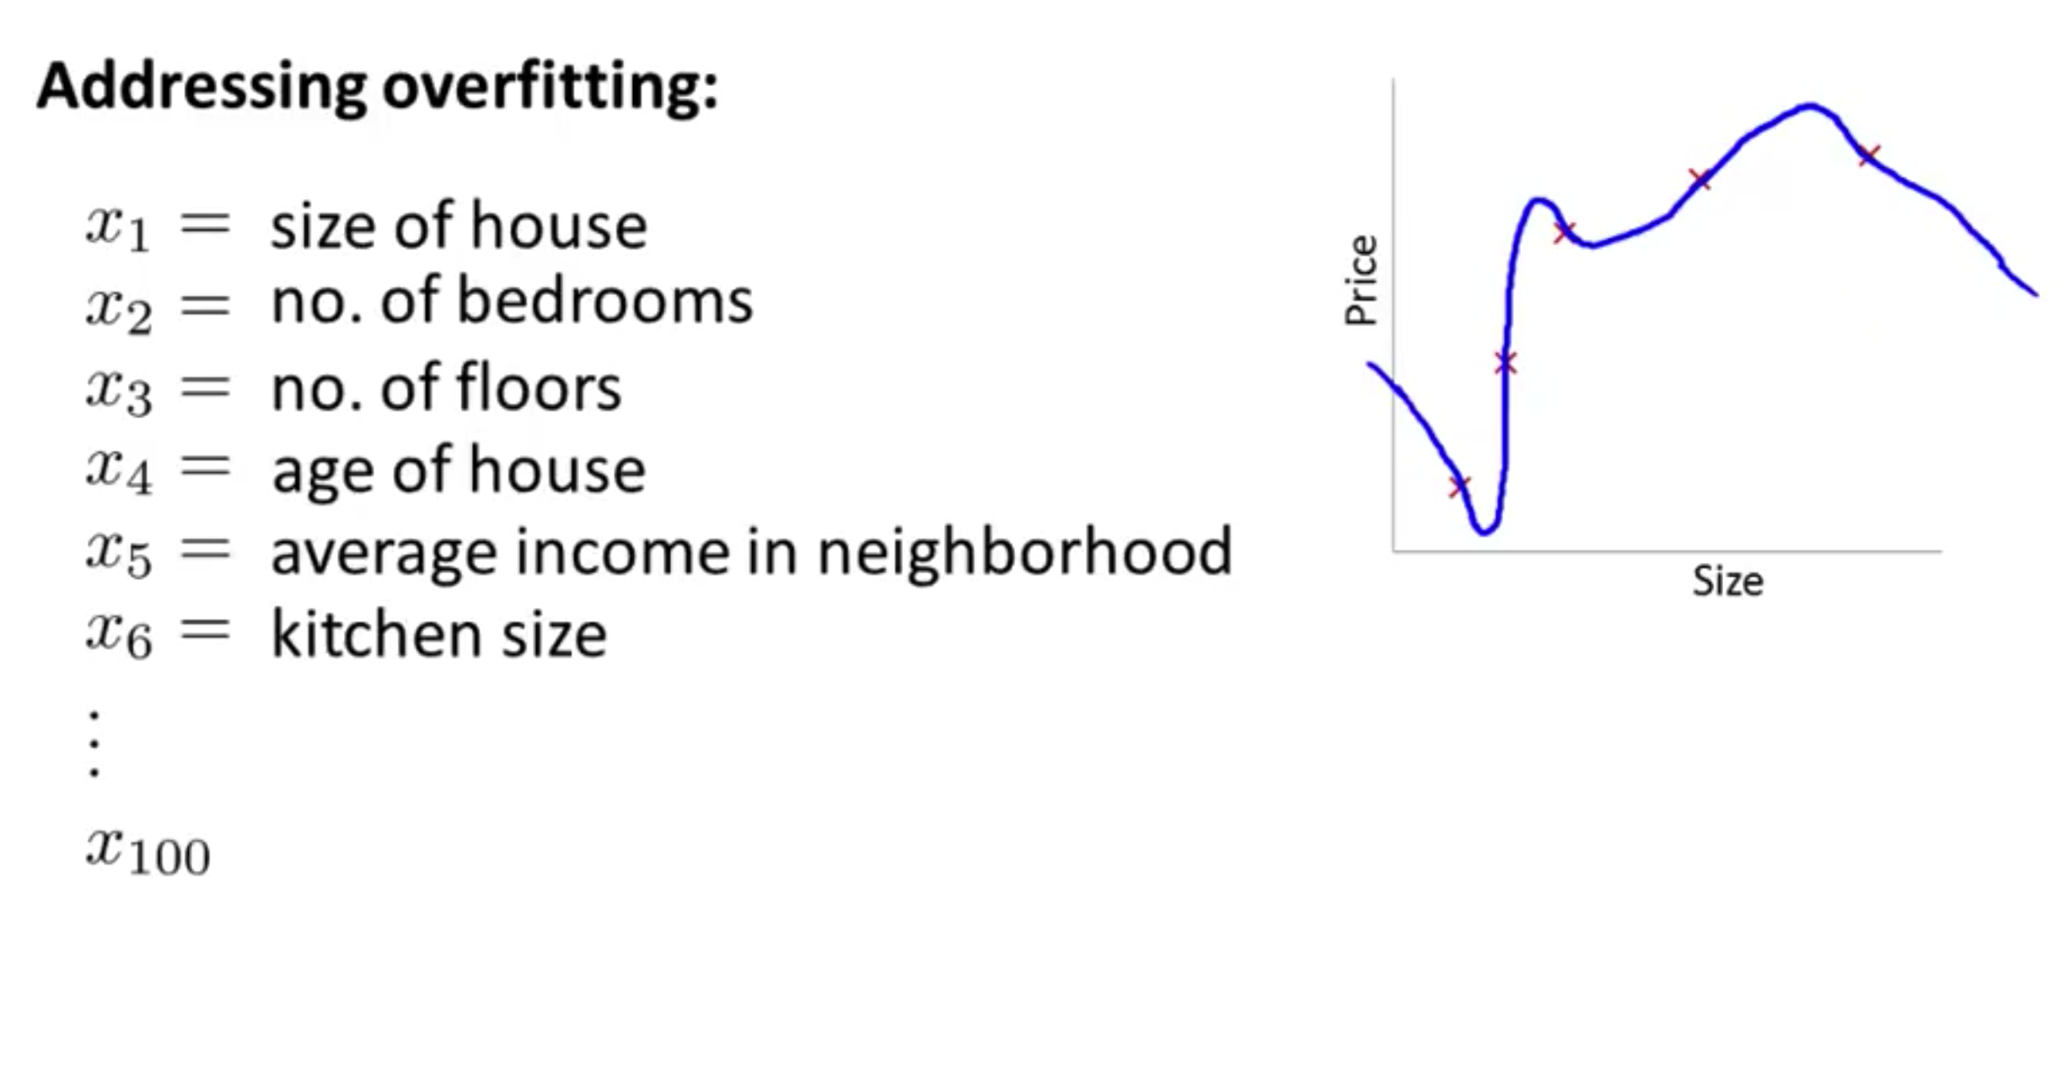
The problem of overfitting

Slide 27
Addressing overfitting
Options:
1. Reduce number of features
- Manually select which feature to keep
- Model selection algorithm
2. Regularization
- Keep all the features, but reduce magnitude/values of parameter Θ_{j}
- Work well when we have a lot of features, each of which contribute a bit to predicting y.

Slide 28
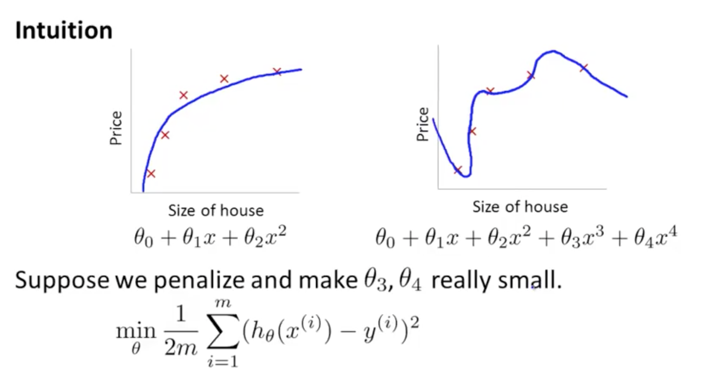
Regularlization
+ 1000𝜃₃² +1000𝜃₄²
𝜃₃ ~ 0 and 𝜃₄ ~ 0

Slide 29
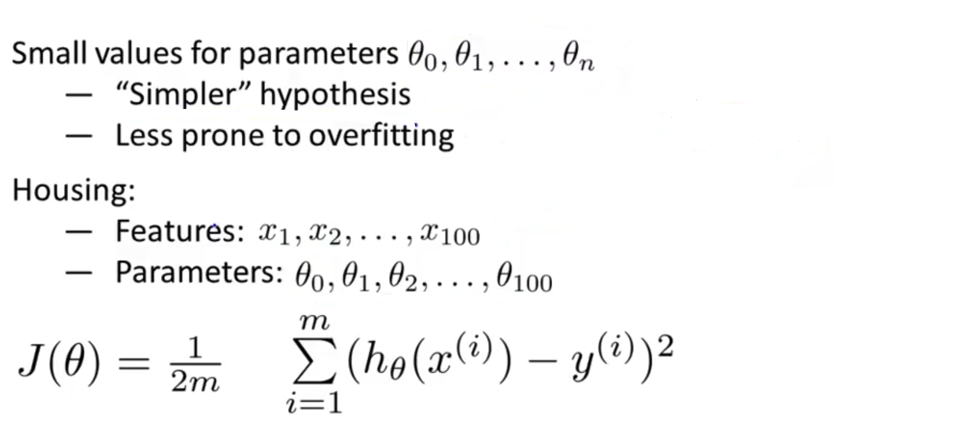
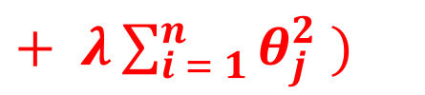
Regularlization
$+ λ\sum_{i = 1}^{n}{θ_{j}^{2} )}$
⁽

Slide 30
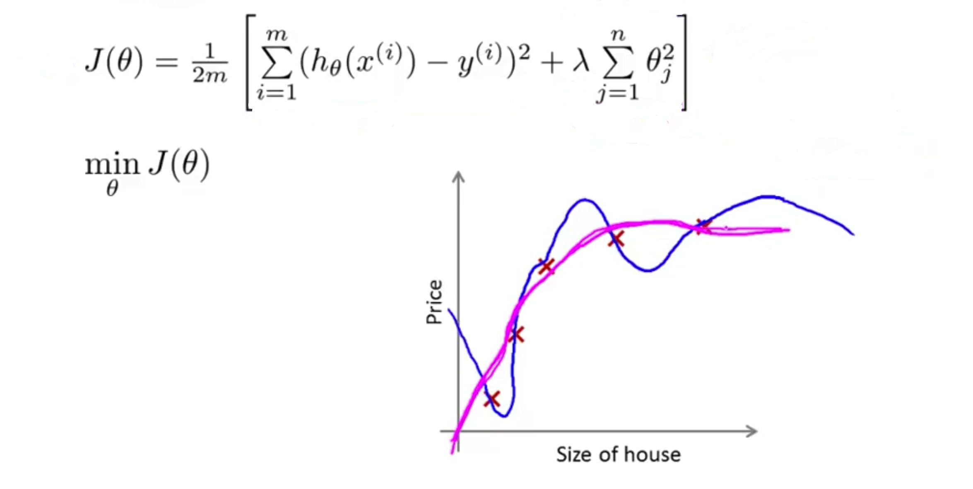
Regularlization
Notes:
Give example for big lamda

Slide 31
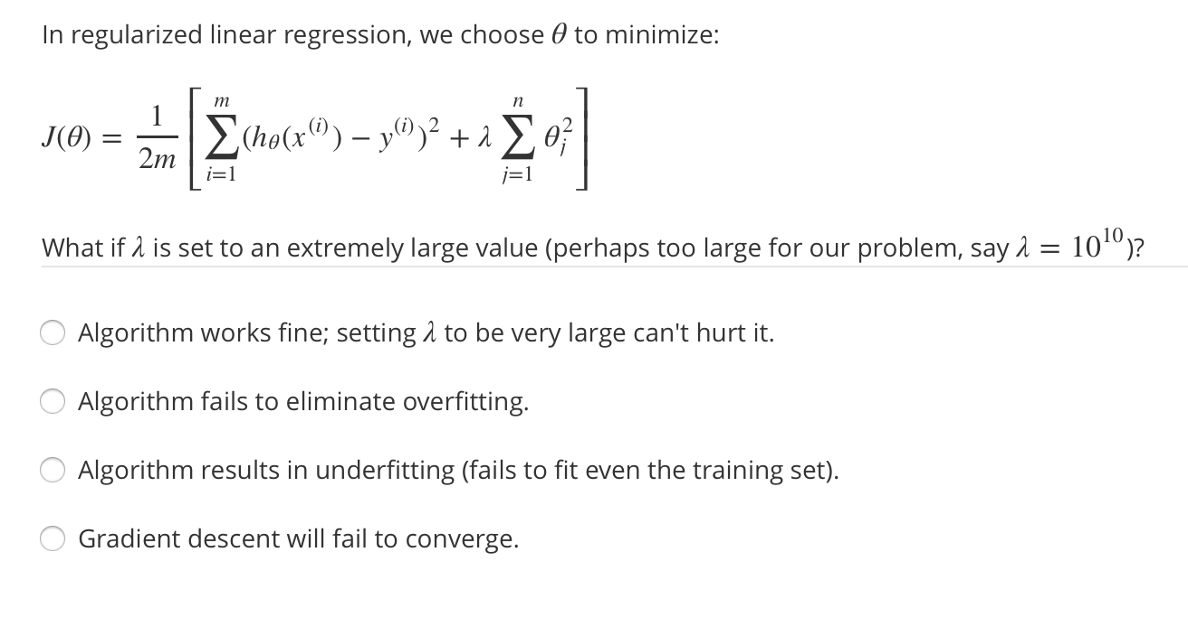
Regularlization
Notes:
Give example for big lamda

Slide 32
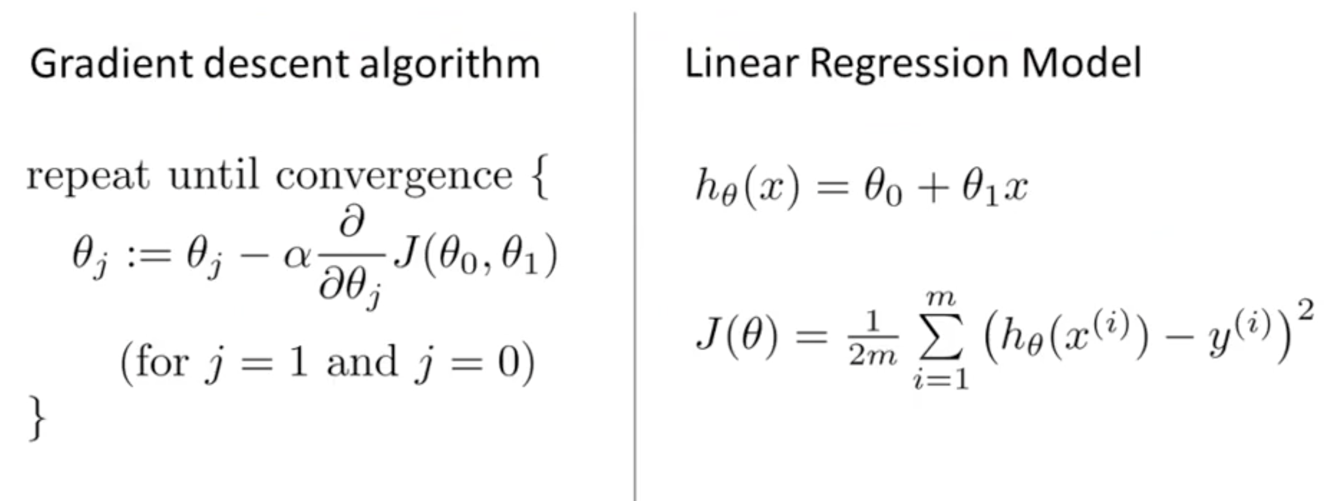
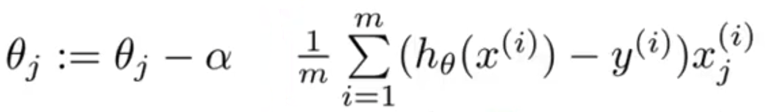
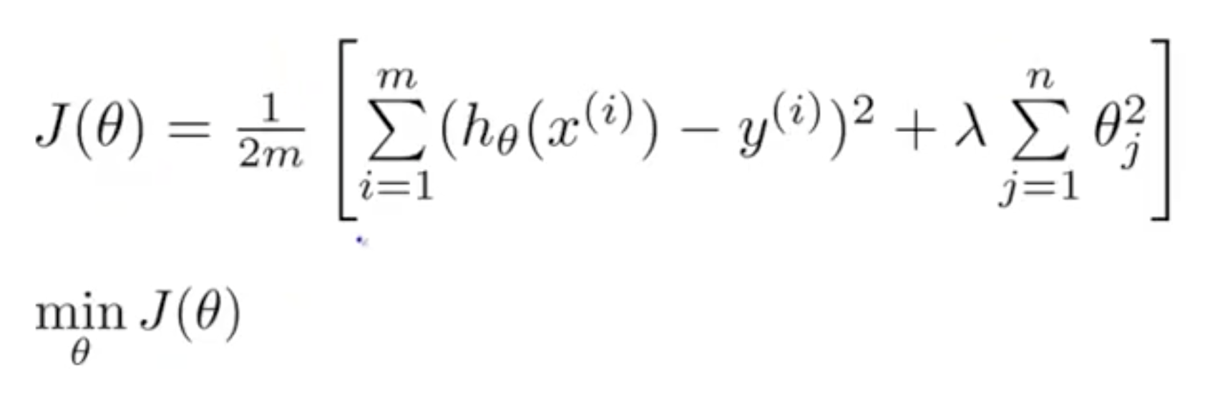
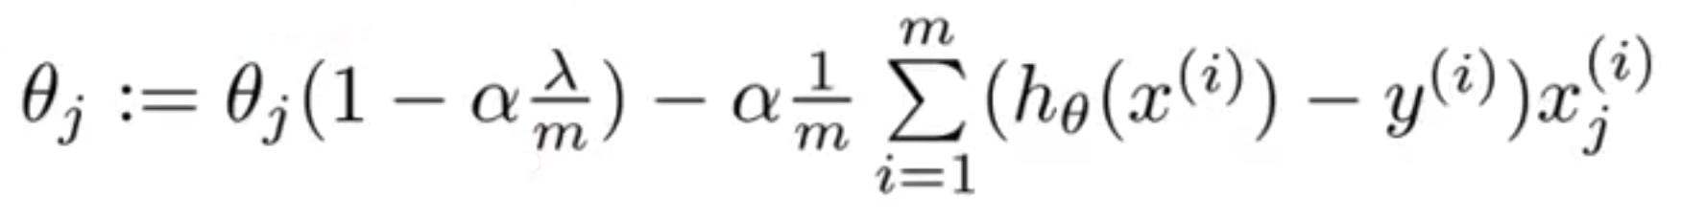
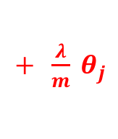
Regularlization
➔ ?
[ ]
$+ \frac{λ}{m} θ_{j}$
Notes:
Give example for big lamda

Slide 33
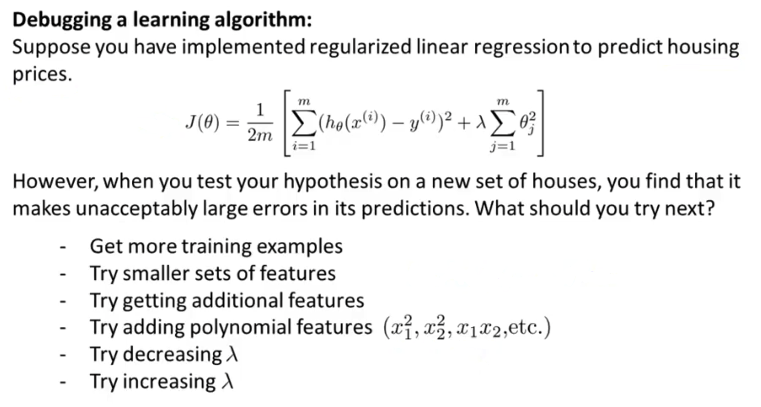
Evaluate a learning algorithm

Slide 34
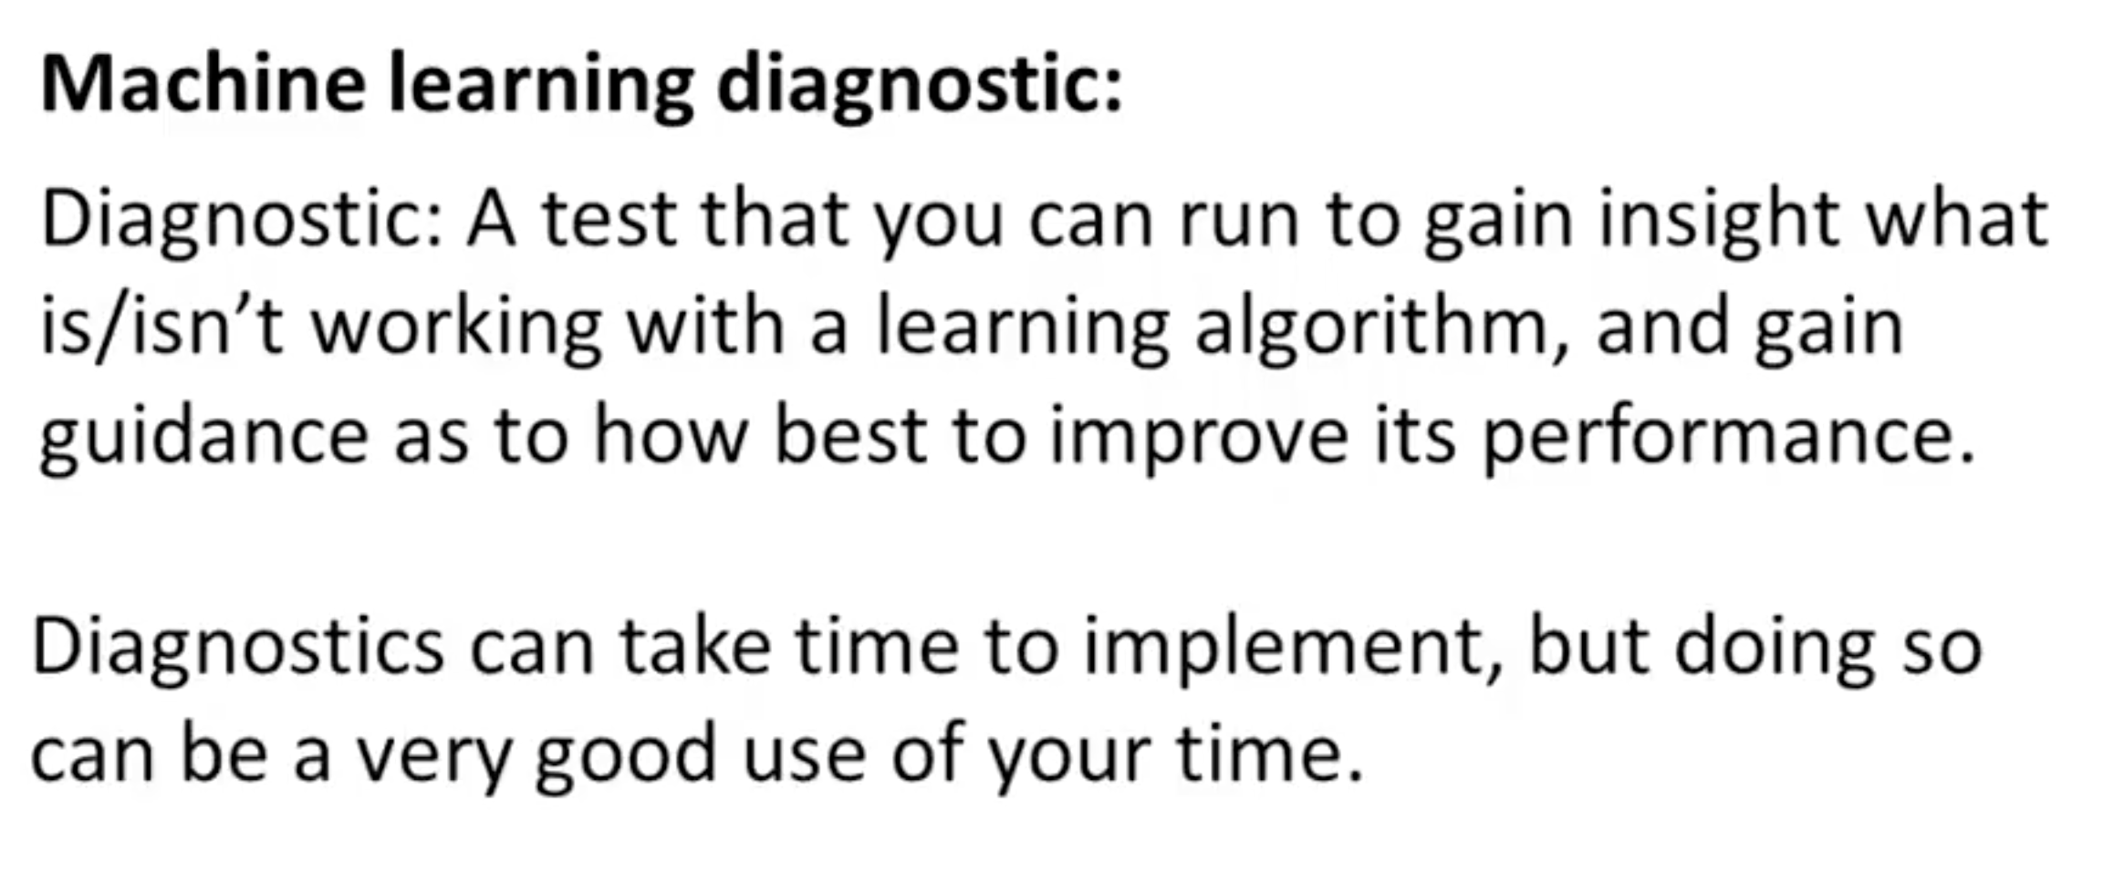
Evaluate a learning algorithm

Slide 35
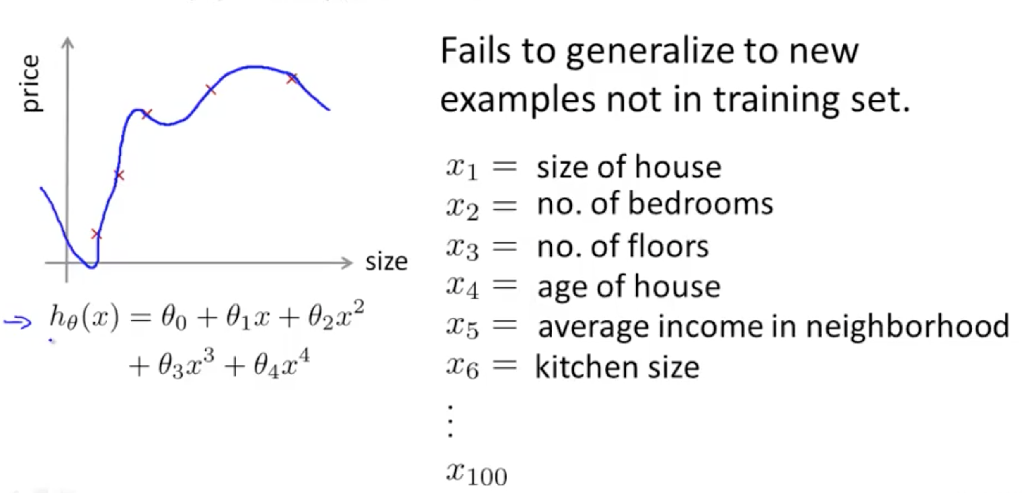
Evaluate your hypothesis

Slide 36
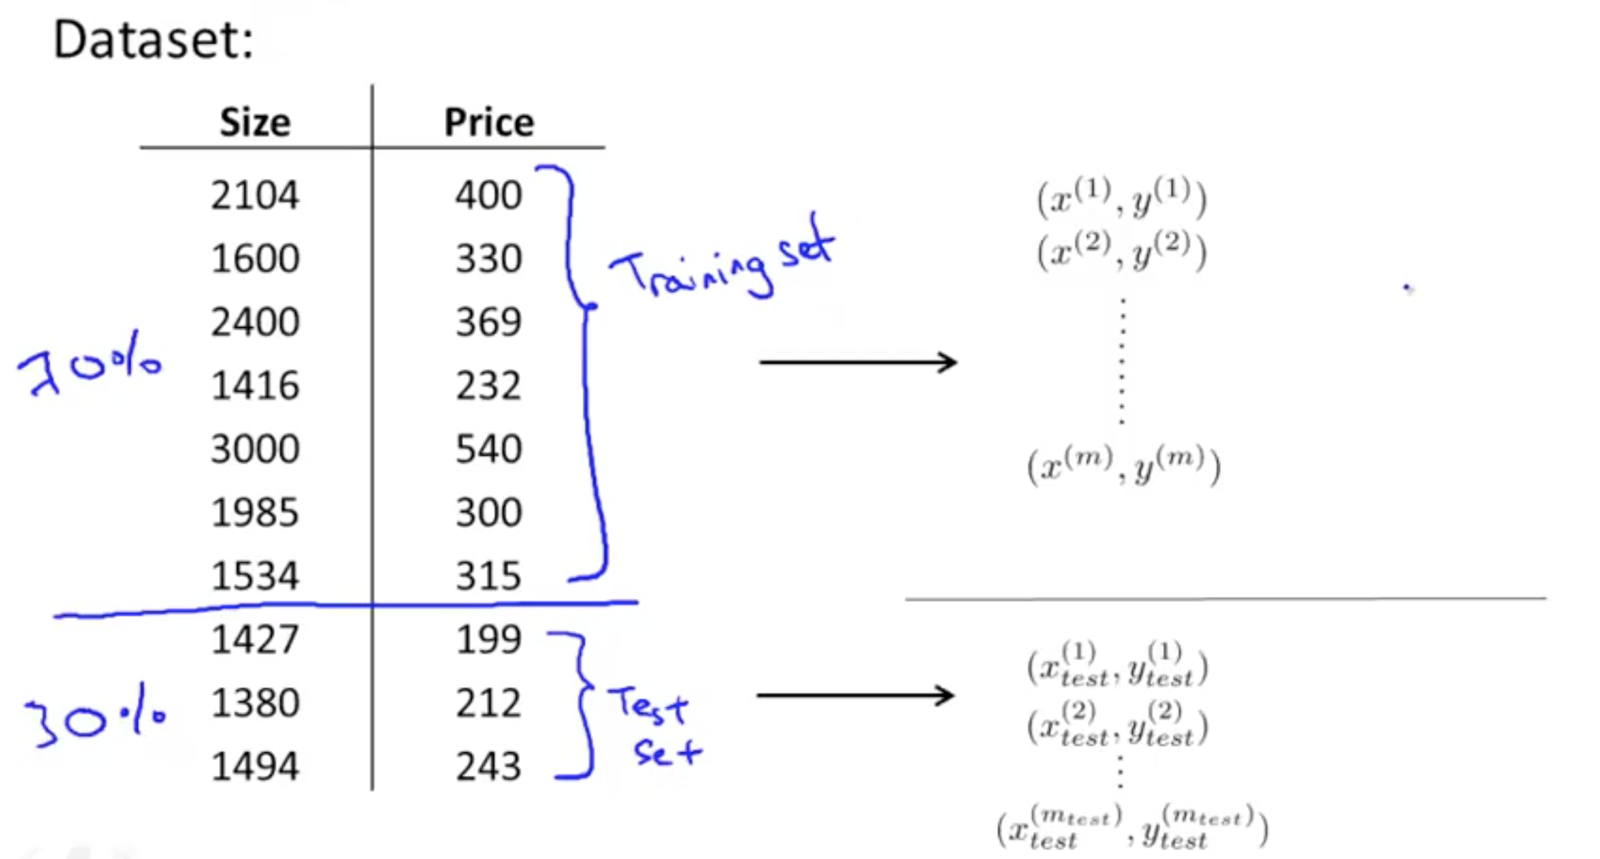
Evaluate your hypothesis

Slide 37
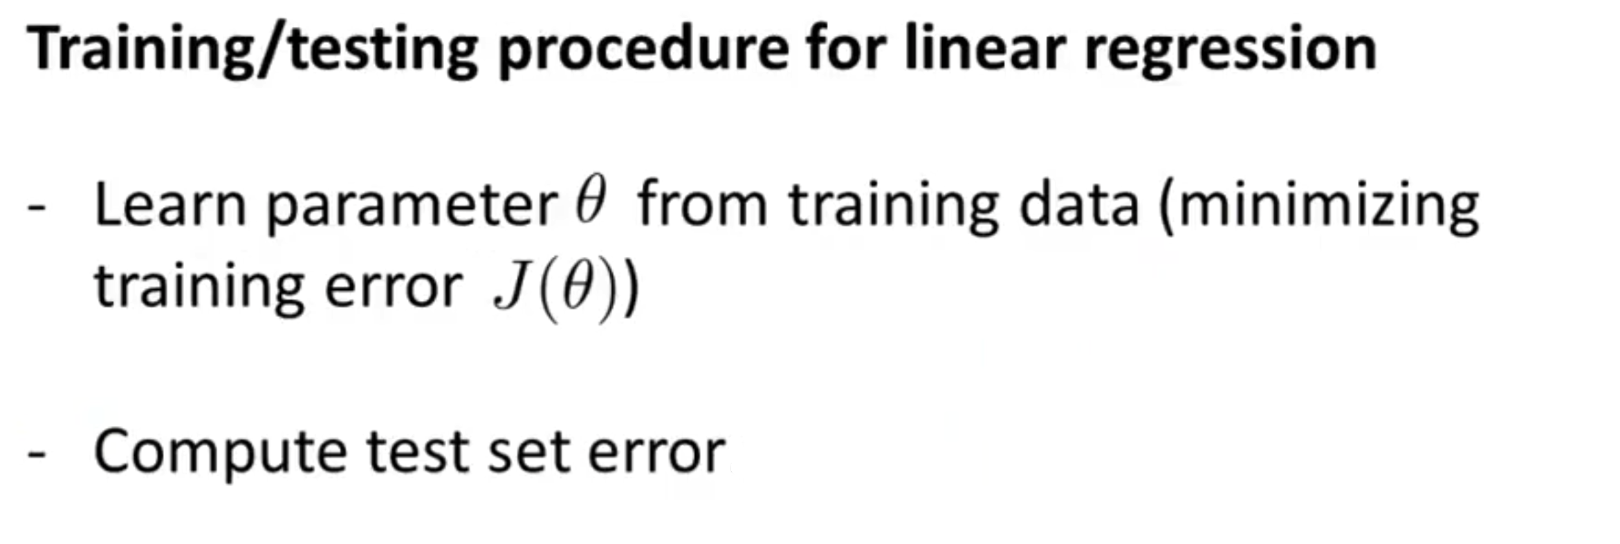
Evaluate your hypothesis

Slide 38
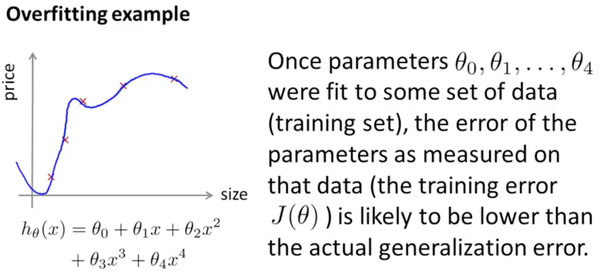
Model selection/train, validation, test set

Slide 39




Model selection/train, validation, test set

Slide 40

Model selection/train, validation, test set

Slide 41

Model selection/train, validation, test set

Slide 42

Diagnose bias vs variance

Slide 43

Diagnose bias vs variance

Slide 44

Diagnose bias vs variance
Bias (underfit):
J_{train} will be high
J_{cv} ~ J_{train}
Variance (Overfit):
J_{train} will be low
J_{cv} >> J_{train}

Slide 45


Choose $λ$ for regularization

Slide 46

Choose $λ$ for regularization

Slide 47



Choose $λ$ for regularization

Slide 48


Choose $λ$ for regularization

Slide 49



Learning curve

Slide 50

Learning curve

Slide 51


Learning curve

Slide 52

WHAT TO DO
→ Fix high variance
→ Fix high variance
→ Fix high bias
→ Fix high bias
→ Fix high bias
→ Fix high variance

